Slide 1




Proactive Streaming Analytics at Scale:
A Journey from the State-of-the-art to a Production Platform
Nikos Giatrakos^{1,2}, Elias Alevizos³, Antonios Deligiannakis¹,
Ralf Klinkenberg⁴, Alexander Artikis^{3,5}
1 Technical University of Crete | 2 Athena Research Center
3 NCSR Demokritos | 4 Altair Engineering GmbH
5 University of Piraeus
Horizon Europe

Slide 2
Outline
Proactive Streaming Analytics at Scale:
                Motivation – Use Cases – Challenges
(Geo-)Distributed Proactive Stream Analytics – State-of-the-art (SOTA)
                The Case for Stream Synopses
                Complex Event Forecasting
                Intra-/Inter-cluster Optimization
Cherry-picks for S/W Components
                Synopses-as-a-Service Paradigm
                Distributed CEF Architecture
                Multi-cluster, Cross-platform & Adaptive Optimization
Hands-On RapidMiner Studio
                Architecture Overview
                Maritime Use Case
                Stock Market Use Case

Slide 3
Outline
Proactive Streaming Analytics at Scale:
                Motivation – Use Cases – Challenges
(Geo-)Distributed Proactive Stream Analytics – State-of-the-art (SOTA)
                The Case for Stream Synopses
                Complex Event Forecasting
                Intra-/Inter-cluster Optimization
Cherry-picks for S/W Components
                Synopses-as-a-Service Paradigm
                Distributed CEF Architecture
                Multi-cluster, Cross-platform & Adaptive Optimization
Hands-On RapidMiner Studio
                Architecture Overview
                Maritime Use Case
                Stock Market Use Case
+Open Issues

Slide 4
Outline
Proactive Streaming Analytics at Scale:
                Motivation – Use Cases – Challenges
(Geo-)Distributed Proactive Stream Analytics – State-of-the-art (SOTA)
                The Case for Stream Synopses
                Complex Event Forecasting
                Intra-/Inter-cluster Optimization
Cherry-picks for S/W Components
                Synopses-as-a-Service Paradigm
                Distributed CEF Architecture
                Multi-cluster, Cross-platform & Adaptive Optimization
Hands-On RapidMiner Studio
                Architecture Overview
                Maritime Use Case
                Stock Market Use Case

Slide 5
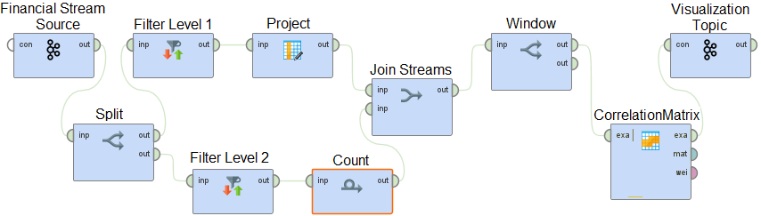
Streaming Analytics
Continuously Executed Workflows of Arbitrarily Complex Operators
Relational-like Operators (Joins, Selections, Windows, …)
Data Mining and Machine Learning Operators
Synopses (Samples, Sketches, Histograms, Dim. Reduction)
Pattern Detection Operators – Complex Event Recognition/Forecasting
User-Defined Functions (UDFs) – Custom Operators
N. Giatrakos et al: INforE: Interactive Cross-platform Analytics for Everyone. CIKM 2020

Slide 6
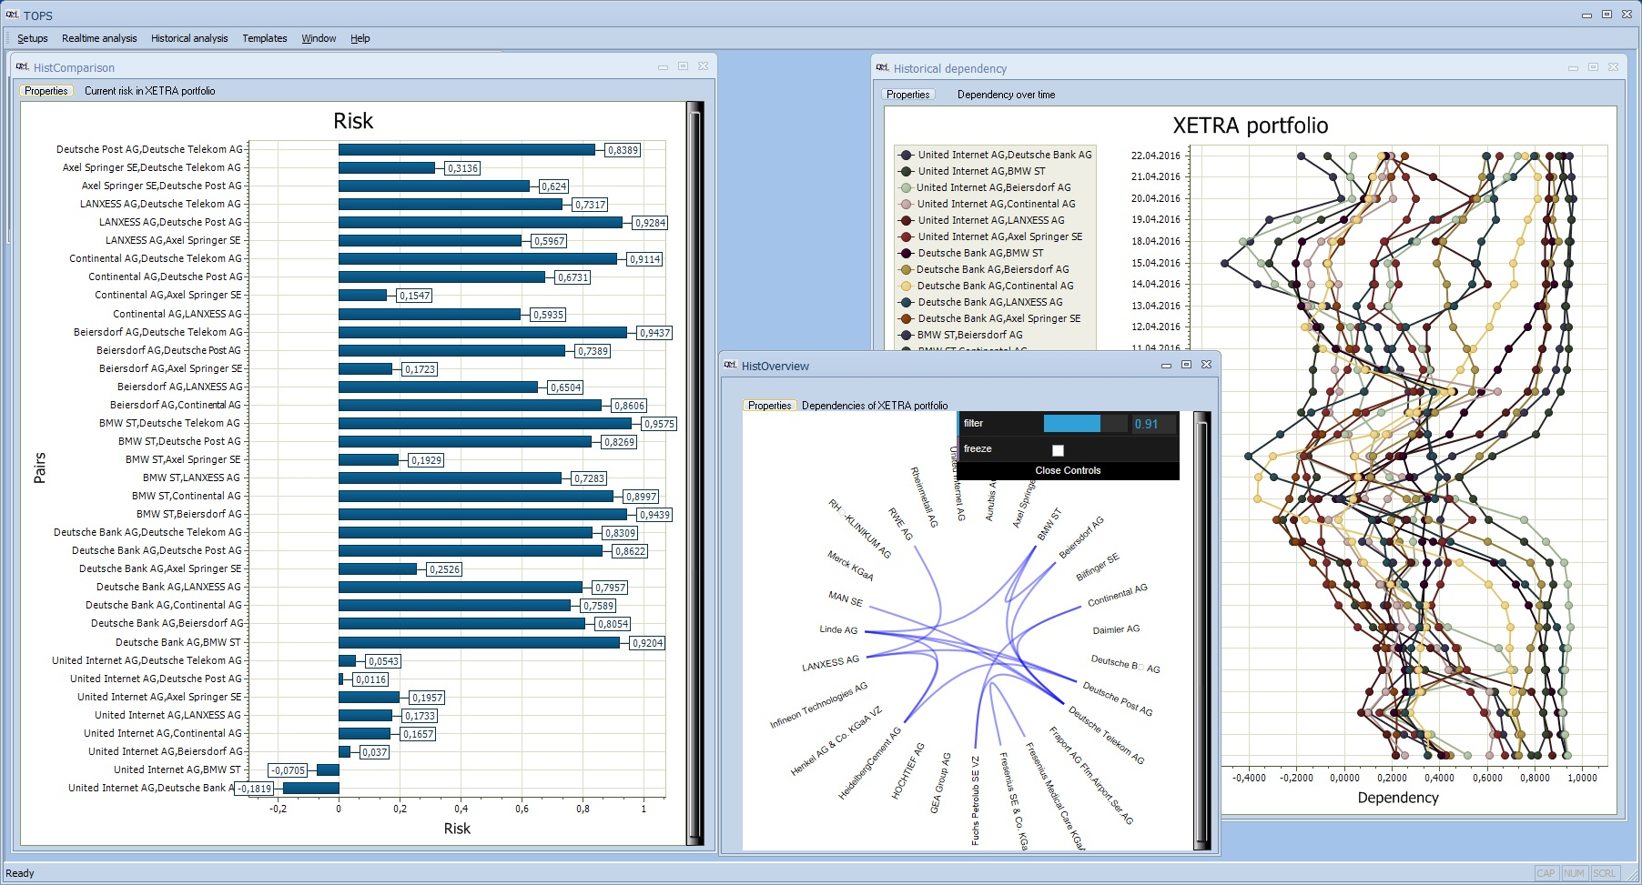
Streaming Analytics – Diversified Portfolio Use Case
N. Giatrakos et al: INforE: Interactive Cross-platform Analytics for Everyone. CIKM 2020

Slide 7
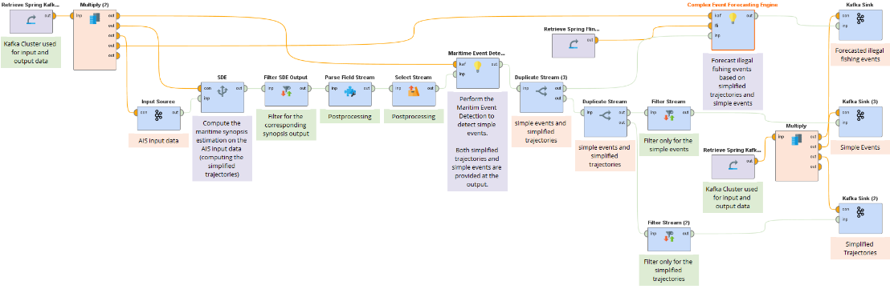
Streaming Analytics
Continuously Executed Workflows of Arbitrarily Complex Operators
Relational-like Operators (Joins, Selections, Windows, …)
Data Mining and Machine Learning Operators
Synopses (Samples, Sketches, Histograms, Dim. Reduction)
Pattern Detection Operators – Complex Event Recognition/Forecasting
User-Defined Functions (UDFs) – Custom Operators
M. Vodas et al: Online Distributed Maritime Event Detection & Forecasting over Big Vessel Tracking Data. IEEE BigData 2021: 2052-2057

Slide 8
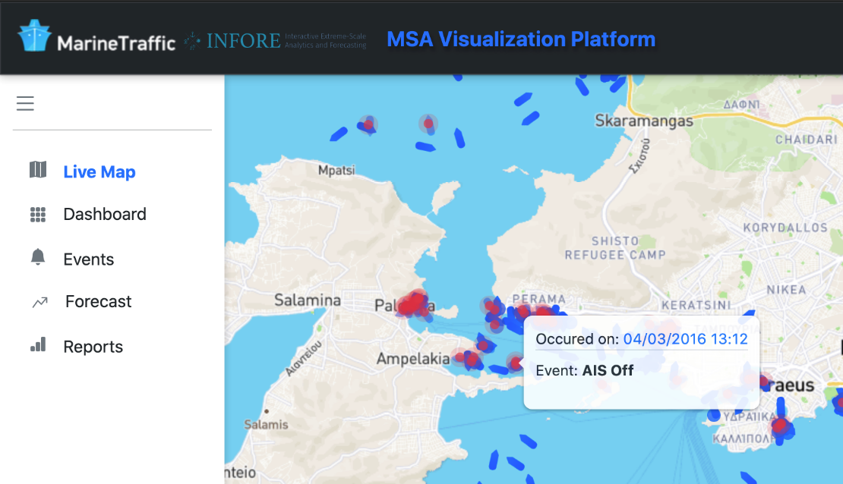
Streaming Analytics – Maritime Surveillence Use Case
M. Vodas et al: Online Distributed Maritime Event Detection & Forecasting over Big Vessel Tracking Data. IEEE BigData 2021

Slide 9
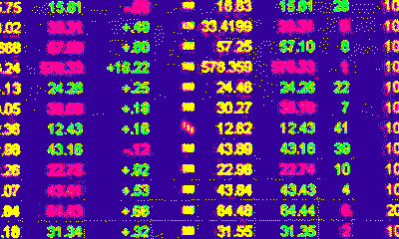
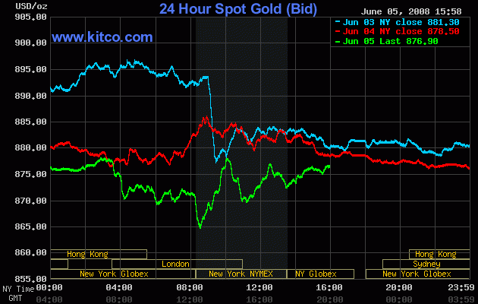
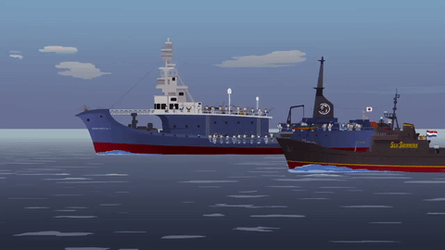
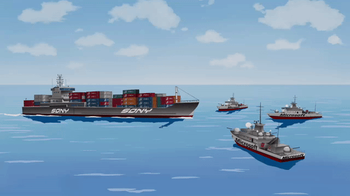
Streaming Analytics at Scale
Diversified Portfolio Use Case
                100s of MBs/min
                Monitoring 1000s of stocks
                Millions of potential stock correlations
Maritime Surveillance Use case
                >200K vessels operate globally
                > 1TB of data upon
                fused with satellite images &
                acoustic signals

Slide 10



Streaming Analytics at Scale
Clustered Architecture
Parallel Processing
Operator Instance 1
INPUT ›
. . .
OUTPUT
. . . . . .
Streaming Output
. . . . . .
. . .
Operator Instance 2
Input Stream
. . . . . .
…
Performance metrics
High Throughput
Low Processing Latency
Operator Instance Q

Slide 11

Streaming Analytics at Scale
…Beyond a Single Cluster/Cloud
11

Slide 12
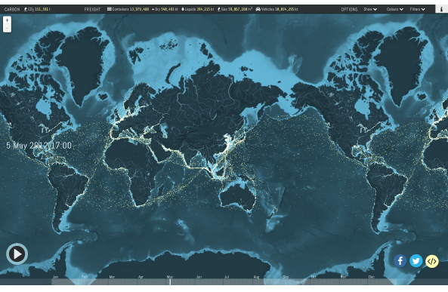

Streaming Analytics at any Scale

Slide 13


Streaming Analytics at any Scale
Broader Motivating Scenaria
Consortiums/coalitions of organizations
Companies Acquiring other companies
Multiple cloud providers supporting different platforms
13

Slide 14
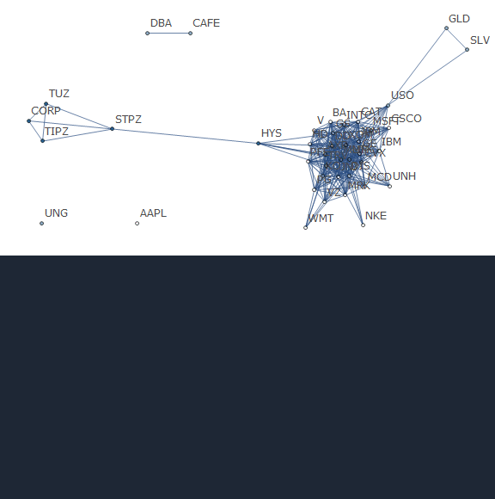
Proactive Streaming Analytics at Scale – Portfolio Use Case
Forecasting instead of Detecting
14

Slide 15
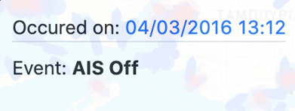
Proactive Streaming Analytics at Scale – Maritime Use Case
Forecasting instead of Detecting
Vessel ID: X
Vessel ID: Y
Potential Smuggling Activity
Authorities Act

Slide 16
Outline
Proactive Streaming Analytics at Scale:
                Motivation – Use Cases – Challenges
(Geo-)Distributed Proactive Stream Analytics – State-of-the-art (SOTA)
                The Case for Stream Synopses
                Complex Event Forecasting
                Intra-/Inter-cluster Optimization
Cherry-picks for S/W Components
                Synopses-as-a-Service Paradigm
                Distributed CEF Architecture
                Multi-cluster, Cross-platform & Adaptive Optimization
Hands-On RapidMiner Studio
                Architecture Overview
                Maritime Use Case
                Stock Market Use Case

Slide 17
The Case for Stream Synopses
Samples, Sketches, Wavelets, Histograms,…
                approximate answers, tunable accuracy guarantees, low memory util
                cardinality, frequency moment, correlation, quantile estimation …
Enhanced Horizontal Scalability (volume, velocity)
                high throughput & low processing latency
Federated Scalability (network size)
                reduces communicated bytes & network latency
Vertical Scalability (number of processed streams)
                reduces computational complexity

Slide 18
Enhanced Horizontal Scalability via Stream Synopses
Min-wise Sampling Example
                Each streaming tuple is assigned a rank i.e., a random value in [0,1]
                Process only k tuples of lowest rank
                Uniform sampling because each tuple has equal probability of getting one of the lowest ranks
                True average price:87,94 – Approximate average price w k=3: 87,946
                True average volume:18,33 – Approximate average vol w k=3: 28
StockID Date Time Price Volume Rank
USDEUR,09/13/2019,12:16:39,87.92,3
USDEUR,09/13/2019,12:16:40,87.92,3
USDEUR,09/13/2019,12:16:42,87.94,12
USDEUR,09/13/2019,12:17:10,87.94,11
USDEUR,09/13/2019,12:17:10,87.94,11
USDEUR,09/13/2019,12:19:04,87.98,70
… … … … …
0.545
0.263
0.627
0.199
0.912
0.291

Slide 19
Federated Scalability via Stream Synopses
++mergeability property
0.012
0.199
0.213
0.263
0.012
0.199
0.213
0.291
0.225

Slide 20




Vertical Scalability via Stream Synopses
Stock correlation example
  Stock time series (e.g. stock prices as time passes)
Hamming Weight – based
hashing
Corr. Threshold
T_{Corr}
28
…
21
18
55
60
1
0
0
1
0
1
1
1
LSH
20
…
20
12
69
60
1
0
0
1
0
1
1
1
$$\frac{corr(u_{i},u_{j})}{π}=\frac{D_{h}(X_{i},X_{j})}{d}$$
3
…
2
4
5
8
1
0
0
1
0
0
0
0
S
d=8<<S
If ${corr(u_{i},u_{j})≤T}_{corr}$
$D_{h}(X_{i},X_{j})≤$ $\frac{\text{T}\text{Corr} }{π}d$
d
4 workers
computing
correlations
0
d/4
d/4
d/2
d/2
3d/4
3d/4
d
| $W_{h}\left(X_{i}\right)−W_{h}(X_{j})$|$≤D_{h}(X_{i},X_{j})$

Slide 21
Stream Synopses SOTA
Status of prominent Big Data platforms
                Apache Spark supports stream processing
                Apache Flink is built from scratch for stream processing
                But…No Native API dedicated to Stream Synopses in No platform
                State-of-the-art Synopsis Libraries do exist though
                Apache DataSketches
                Stream-lib
                Efforts on parallel stream summary maintenance as well
                SnappyData SDE
                StreamApprox
                Condor

Slide 22
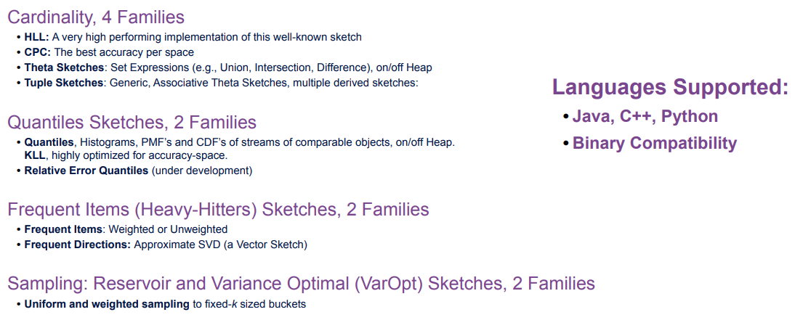
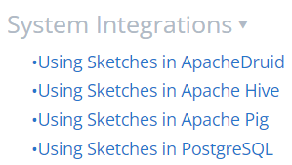
Apache DataSketches
https://datasketches.apache.org/docs/Community/KDD_Tutorial_Summary.html

Slide 23
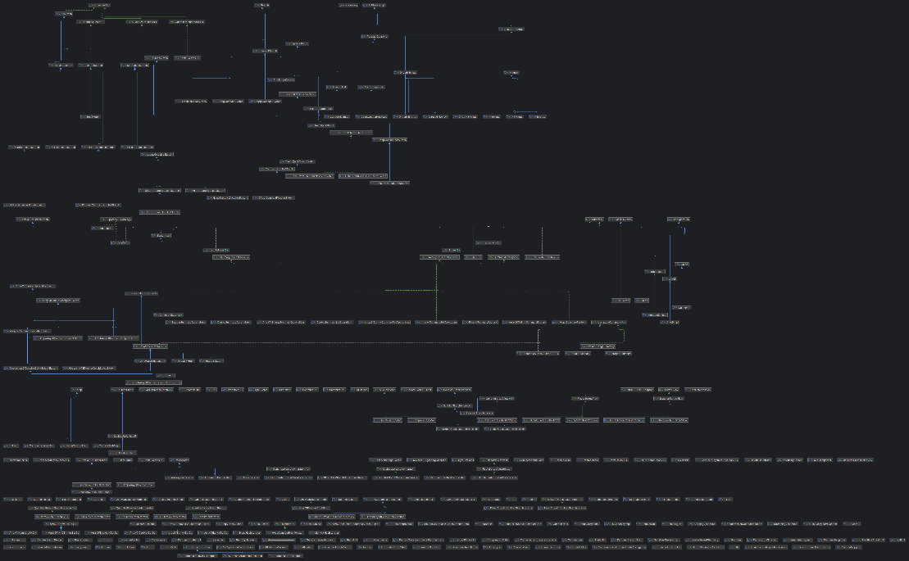
Apache DataSketches
Extensibility
Concerns

Slide 24
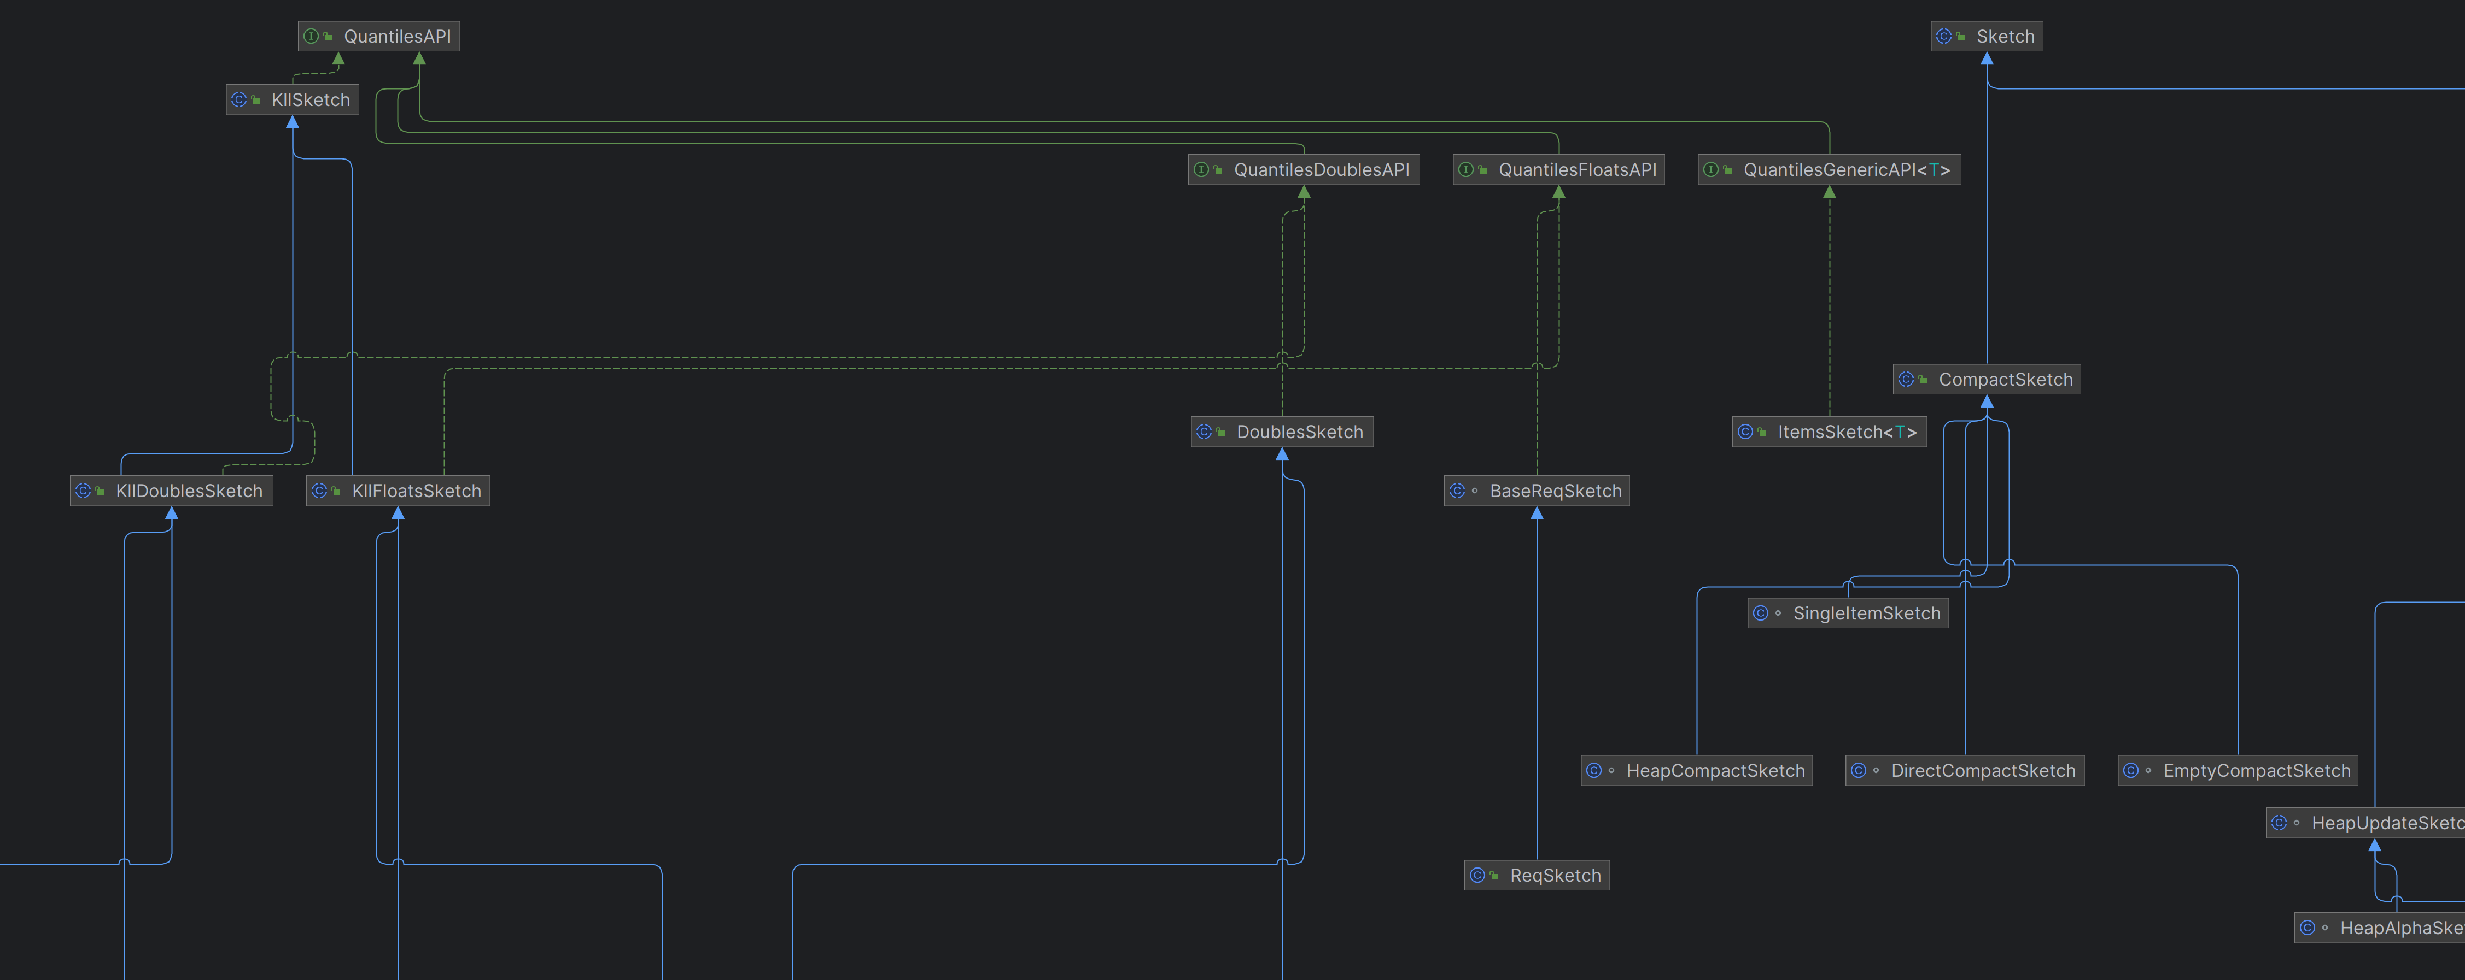
Apache DataSketches

Slide 25
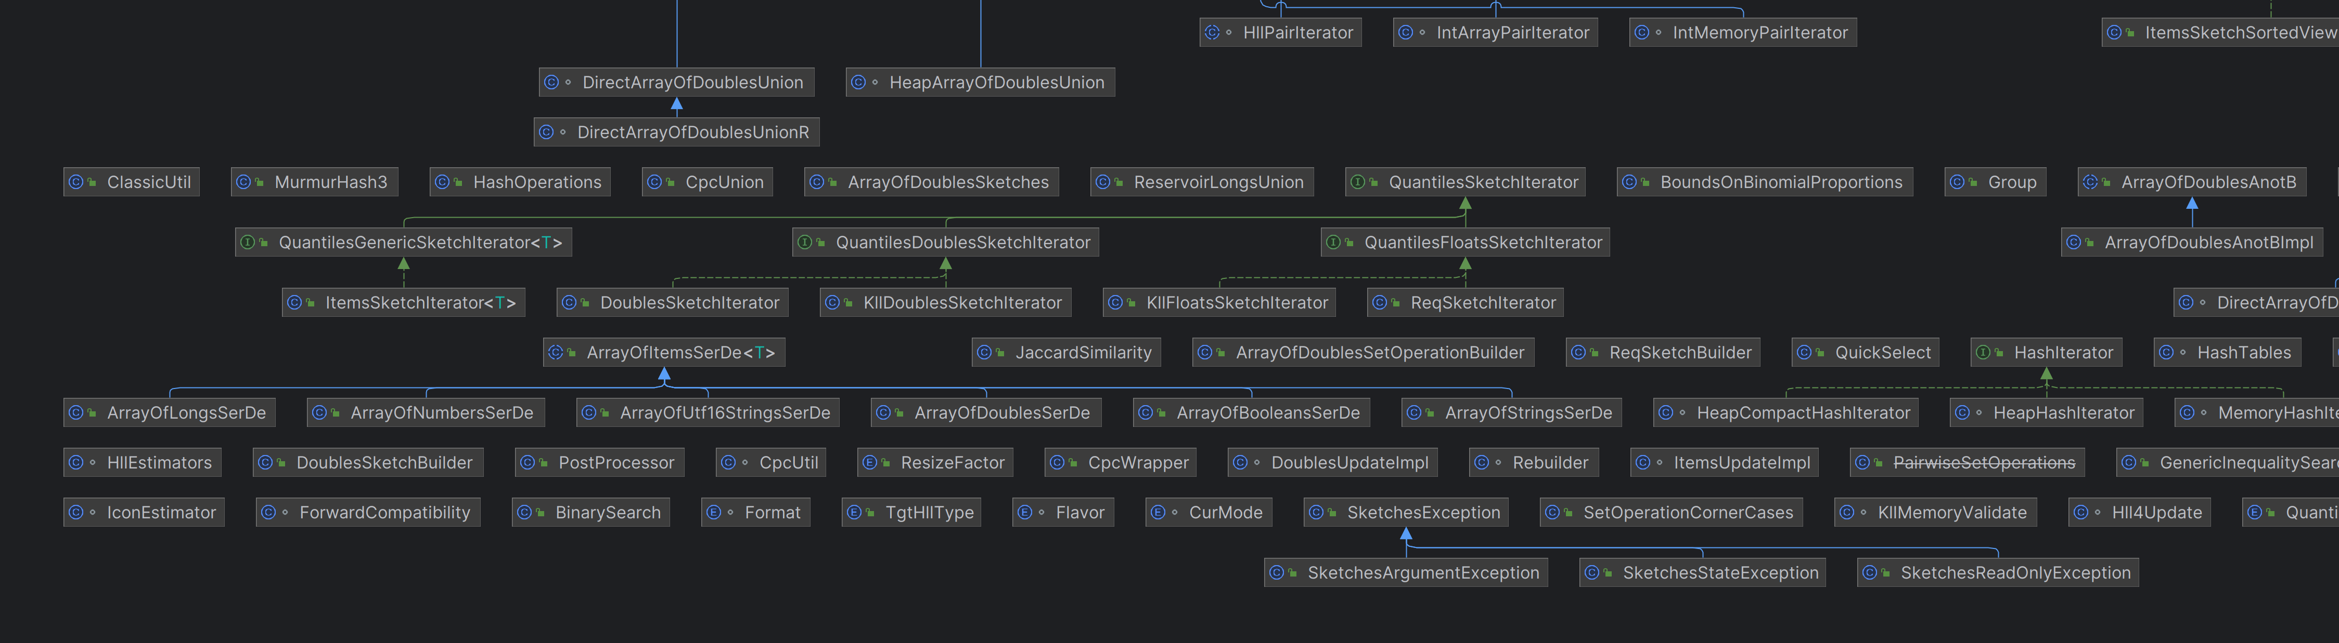
Apache DataSketches

Slide 26
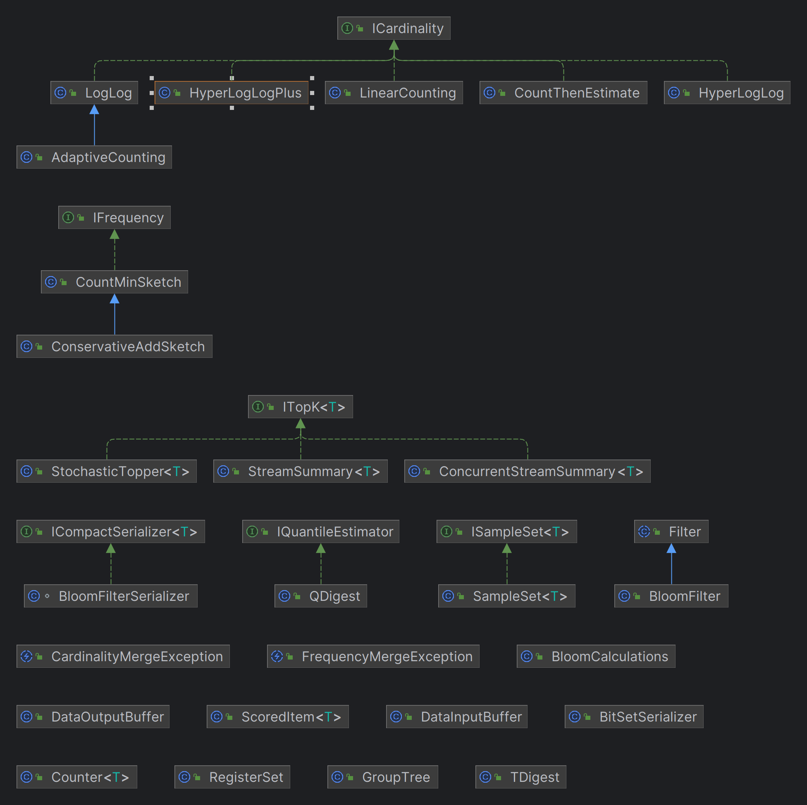
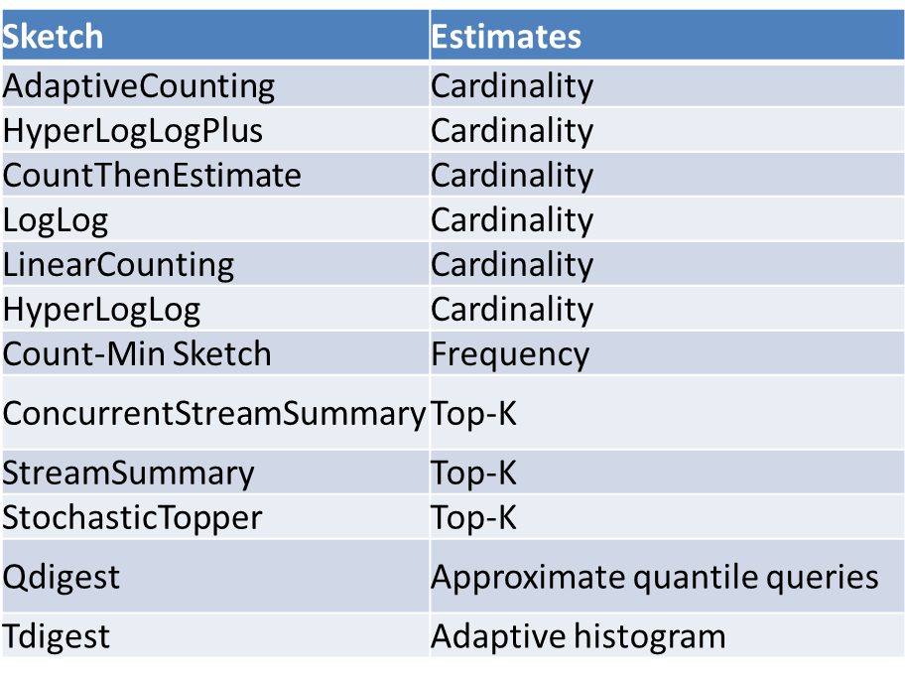
Stream-lib

Slide 27
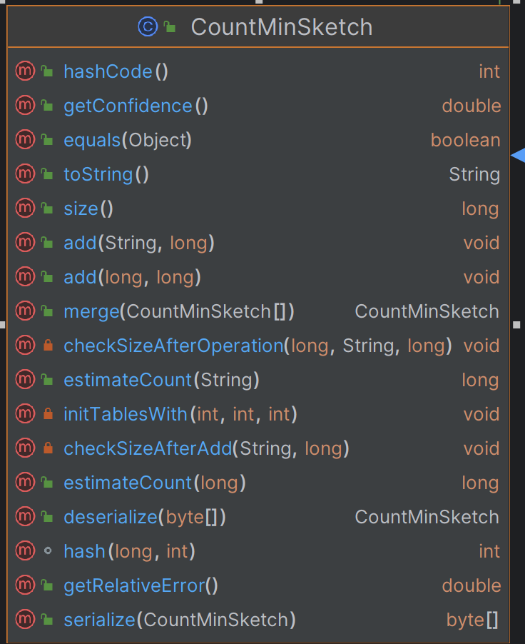
Stream-lib
Essentials

Slide 28






Snappy Data SDE & StreamApprox
Data
Sources
. . .
. . .
Stream Summary @ Worker 1
... . . .
Input Stream @ Worker 1
... . . . . .
StreamApprox
Stratified
Sampling
…
…
Snappy Data
Sampling
Count-Min Sketch

Slide 29
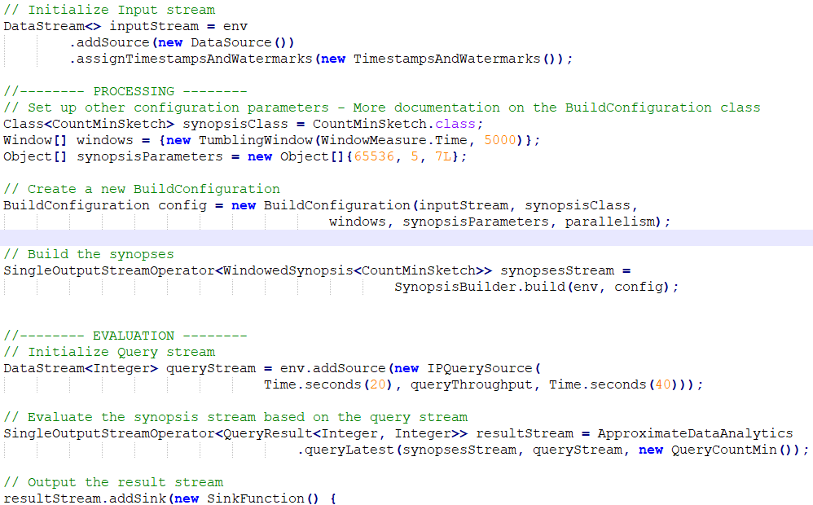
The Condor Approach
queryRuntime, queryThroughput, waiting time
R. P. Lemaitre, M. Kiefer, J.V. Hein, J.A. Quiané-Ruiz, V. Markl: In the Land of Data Streams where Synopses are Missing, One Framework to Bring Them All. PVLDB, 14(10): (2021)

Slide 30
The Condor Approach
Parallel Synopsis Computation → Horizontal Scalability
                Query-based parallelism/synopses sharing
                Key-based parallelization
                Window-based parallelization
Features
                Simple programming API
                Collection of 12 supported synopses
                Scales linearly to the number of available cores

Slide 31



Add – Merge – Estimate Motif
Mergeable Synopses
Non – mergeable Synopses

Slide 32
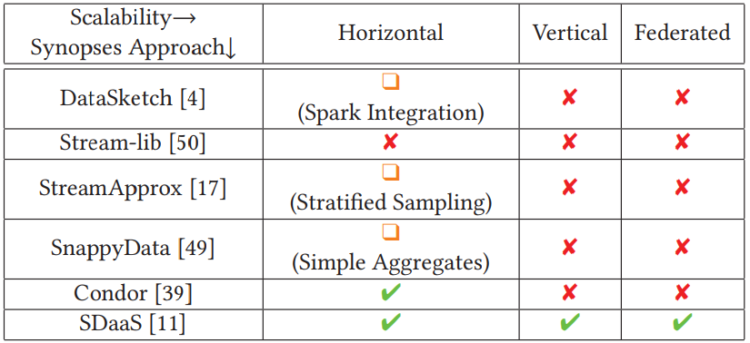
Stream Synopses SOTA Overview

Slide 33
Outline
Proactive Streaming Analytics at Scale:
                Motivation – Use Cases – Challenges
(Geo-)Distributed Proactive Stream Analytics – State-of-the-art (SOTA)
                The Case for Stream Synopses
                Complex Event Forecasting
                Intra-/Inter-cluster Optimization
Cherry-picks for S/W Components
                Synopses-as-a-Service Paradigm
                Distributed CEF Architecture
                Multi-cluster, Cross-platform & Adaptive Optimization
Hands-On RapidMiner Studio
                Architecture Overview
                Maritime Use Case
                Stock Market Use Case

Slide 34


Complex Event Forecasting (CEF)∗,†
Input ..,
Forecasting ..,
Output •
. . . . . .
Recognised Complex Events
. . . . . .
. . .
. . .
Event Forecasting System
Simple Events
. . . . . .
slowSpeedStart (ID0 , 22 /2 /18 .00 :00 :12 )
turn(ID0 , 11 , 22 /2 /18 .00 :03 :12 )
turn(ID0 , 12 , 22 /2 /18 .00 :06 :46 )
slowSpeedEnd (ID0 , 22 /2 /18 .00 :10 :33 )
. . .
Complex Event Definitions
PATTERN
SEQ(slowSpeedStart(VesselId, Timestamp), ITER(turn(VesselId, TurnRate, Timestamp)), slowSpeedEnd (VesselId, Timestamp))
turn[i ].TurnRate > 10
WHERE
PARTITION BY
VesselId 3600
WITHIN
∗Giatrakos et al, Complex Event Recognition in the Big Data Era: A Survey. VLDB Journal, 2020.
† Alevizos et al, Probabilistic Complex Event Recognition: A Survey. ACM Computing Surveys, 2017.

Slide 35


Complex Event Forecasting (CEF)∗,†
Input ..,
Forecasting ..,
Output •
. . . . . .
Recognised Complex Events
. . . . . .
. . . . . .
Forecast Complex Events
. . . . . .
. . .
. . .
Event Forecasting System
Simple Events
. . . . . .
slowSpeedStart (ID0 , 22 /2 /18 .00 :00 :12 )
turn(ID0 , 11 , 22 /2 /18 .00 :03 :12 )
turn(ID0 , 12 , 22 /2 /18 .00 :06 :46 )
slowSpeedEnd (ID0 , 22 /2 /18 .00 :10 :33 )
. . .
Complex Event Definitions
PATTERN
SEQ(slowSpeedStart(VesselId, Timestamp), ITER(turn(VesselId, TurnRate, Timestamp)), slowSpeedEnd (VesselId, Timestamp))
turn[i].TurnRate > 10
WHERE
PARTITION BY
VesselId 3600
WITHIN
∗Giatrakos et al, Complex Event Recognition in the Big Data Era: A Survey. VLDB Journal, 2020.
† Alevizos et al, Probabilistic Complex Event Recognition: A Survey. ACM Computing Surveys, 2017.

Slide 36
Complex Event Forecasting (CEF)
start
^{slowSpeedStart} TurnRate = 11 TurnRate = 12
0 1 1 · · ·
▶ Is this a fishing manoeuvre?
▶ How long will it last?
▶ With what probability?

Slide 37
Complex Event Forecasting (CEF)
▶ Is this a fishing manoeuvre?
▶ How long will it last?
▶ With what probability?
▶ Given a stream of events S and a pattern R,
▶ Recognition: Find the ‘full matches’ of R in S.
start
^{slowSpeedStart} TurnRate = 11 TurnRate = 12
0 1 1 · · ·

Slide 38
Complex Event Forecasting (CEF)
▶ Is this a fishing manoeuvre?
▶ How long will it last?
▶ With what probability?
▶ Given a stream of events S and a pattern R,
▶ Recognition: Find the ‘full matches’ of R in S.
▶ Forecast the full matches.
start
^{slowSpeedStart} TurnRate = 11 TurnRate = 12
0 1 1 · · ·

Slide 39
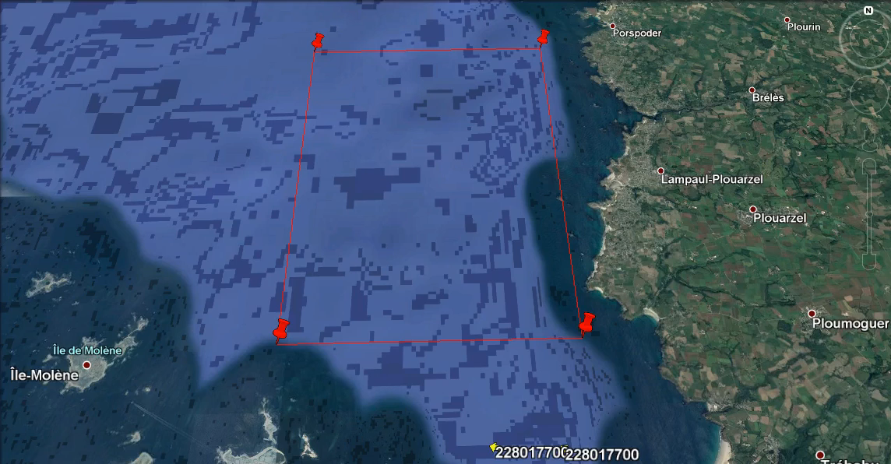
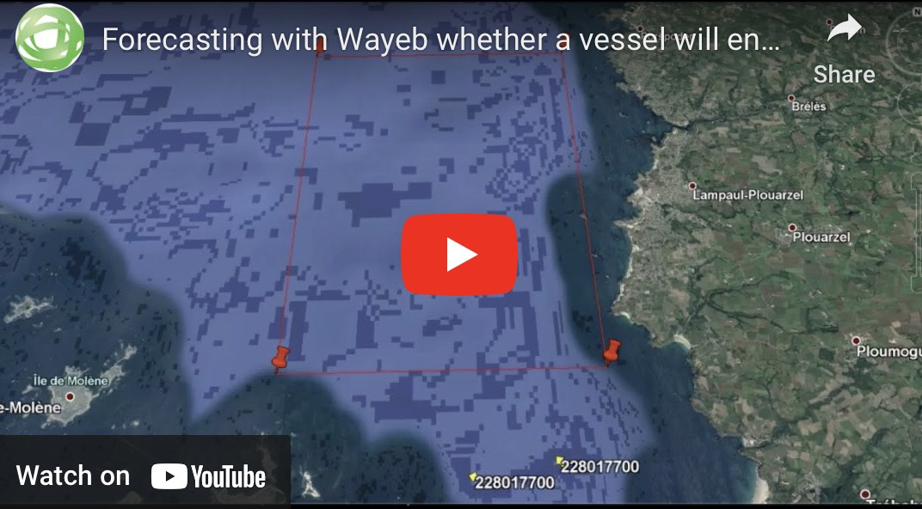
Wayeb: A Complex Event Forecasting system∗
https://cer.iit.demokritos.gr (forecasting)
∗https://github.com/ElAlev/Wayeb

Slide 40
Complex Event Forecasting vs Machine Learning
▶ In Machine Learning, the goal is to predict the output of a function on previously unseen input data.
▶ The input data need not necessarily have a temporal dimension.

Slide 41
Complex Event Forecasting vs Machine Learning
▶ In Machine Learning, the goal is to predict the output of a function on previously unseen input data.
▶ The input data need not necessarily have a temporal dimension.
▶ In Complex Event Forecasting, the task is to predict the temporally future output of a function, i.e., the future occurrence of an event.
▶ Time is thus a crucial component.
▶ From the (current) timepoint where a forecast is produced until the (future) timepoint for which we try to make a forecast, no data is available.

Slide 42
Complex Event Forecasting vs Machine Learning
We have Deep Learning and it seems to work. Can we go home?

Slide 43
Complex Event Forecasting vs Machine Learning
We have Deep Learning and it seems to work. Can we go home?
Complex event forecasting:
▶ Formal semantics∗ for trustworthy models.
∗Grez et al, A Formal Framework for Complex Event Recognition. ACM Transactions on Database Systems, 2021.

Slide 44
Complex Event Forecasting vs Machine Learning
We have Deep Learning and it seems to work. Can we go home?
Complex event forecasting:
▶ Formal semantics∗ for trustworthy models.
▶ Explanation — why did we forecast a complex event?
∗Grez et al, A Formal Framework for Complex Event Recognition. ACM Transactions on Database Systems, 2021.

Slide 45
Complex Event Forecasting vs Machine Learning
We have Deep Learning and it seems to work. Can we go home?
Complex event forecasting:
▶ Formal semantics∗ for trustworthy models.
▶ Explanation — why did we forecast a complex event?
▶ Machine Learning is necessary. But:
▶ Complex events are rare.
▶ Supervision is scarce.
∗Grez et al, A Formal Framework for Complex Event Recognition. ACM Transactions on Database Systems, 2021.

Slide 46
Complex Event Forecasting vs Machine Learning
We have Deep Learning and it seems to work. Can we go home?
Complex event forecasting:
▶ Formal semantics∗ for trustworthy models.
▶ Explanation — why did we forecast a complex event?
▶ Machine Learning is necessary. But:
▶ Complex events are rare.
▶ Supervision is scarce.
▶ More often than not, background knowledge is available — let’s use it!
∗Grez et al, A Formal Framework for Complex Event Recognition. ACM Transactions on Database Systems, 2021.

Slide 47
Automata-based Complex Event Forecasting∗
▶ Patterns defined as regular expressions.
∗Alevizos et al, Event Forecasting with Pattern Markov Chains. Distributed and Event-based Systems (DEBS), 2017.

Slide 48
Automata-based Complex Event Forecasting∗
▶ Patterns defined as regular expressions.
▶ Consume streams of events and forecast when a pattern is expected to be fully matched.
∗Alevizos et al, Event Forecasting with Pattern Markov Chains. Distributed and Event-based Systems (DEBS), 2017.

Slide 49
Automata-based Complex Event Forecasting∗
▶ Patterns defined as regular expressions.
▶ Consume streams of events and forecast when a pattern is expected to be fully matched.
▶ Revise forecasts to reflect changes in the ‘state’ of the pattern.
∗Alevizos et al, Event Forecasting with Pattern Markov Chains. Distributed and Event-based Systems (DEBS), 2017.

Slide 50
Approach overview
▶ Given a stream of events S and a pattern R:
▶ Convert R into an automaton A.

Slide 51
Approach overview
▶ Given a stream of events S and a pattern R:
▶ Convert R into an automaton A.
▶ Feed S to A.

Slide 52
Approach overview
▶ Given a stream of events S and a pattern R:
▶ Convert R into an automaton A.
▶ Feed S to A.
▶ For every (non-final) state A finds itself in, estimate the probability of reaching its final state within some window w .

Slide 53
Approach overview
▶ Given a stream of events S and a pattern R:
▶ Convert R into an automaton A.
▶ Feed S to A.
▶ For every (non-final) state A finds itself in, estimate the probability of reaching its final state within some window w .
▶ If the model is confident enough, emit a forecast.

Slide 54
Approach overview
▶ Given a stream of events S and a pattern R:
▶ Convert R into an automaton A.
▶ Feed S to A.
▶ For every (non-final) state A finds itself in, estimate the probability of reaching its final state within some window w.
▶ If the model is confident enough, emit a forecast.
▶ We may also emit a future interval within which a complex event is expected.

Slide 55
Probability Estimation
▶ Convert pattern automata into Markov chains to produce a probabilistic model for the automaton’s behaviour.

Slide 56
Probability Estimation
▶ Convert pattern automata into Markov chains to produce a probabilistic model for the automaton’s behaviour.
▶ How long (number of transitions) will we have to wait before reaching the final state?
▶ Calculate the waiting-time distribution for each state.

Slide 57
Probability Estimation
▶ Convert pattern automata into Markov chains to produce a probabilistic model for the automaton’s behaviour.
▶ How long (number of transitions) will we have to wait before reaching the final state?
▶ Calculate the waiting-time distribution for each state.
▶ Scan the waiting-time distributions to produce forecasts.

Slide 58
Regular Expression → Pattern Markov Chain
R = a · c · c. Σ = {a, b, c}.
No memory.
b, c
b a
a
0
b
c c
1 2
a
start
3
a
b, c

Slide 59
Regular Expression → Pattern Markov Chain
R = a · c · c. Σ = {a, b, c}.
No memory.
b, c
b
c
1
a
a
a
0
b
c
2
start
3
a
b, c
P (b)
P (b) + P (c)
P (a)
1.0
P (c)
P (c)
0
1
2
3
P (b)
P (a)
P (a)

Slide 60
Regular Expression → Pattern Markov Chain
R = a · c · c.
Σ = {a, b, c}.
P (b | c)
m = 1.
P (b | b) P (a | a)
1.0
P (a | b) P (c | a)
P (c | c)
0_{b} 1_{a}
2_{c}
3_{c}
P (b | a) P (a | c)
P (c | b)
P (b | c)
P (a | c)
0_{c}
P (c | c)

Slide 61
Waiting-Time and Forecasts
▶ Assume R := a · b · b · b; Σ = {a, b}; and no memory.
a
a
a
a b b b start 0 1 2 3 4
b
a
b
1
Completion Probability
state:0 interval:5,12 state:1 state:2 state:3
0.8
0.6
0.4
0.2
0
1 2 3 4 5 6 7 8
9 10 11 12
Number of future events

Slide 62
Example: R = a · b · b · b.
a
a
a
start
a b___ b__ b
0 1 2 3 4
b
a
b
1
state:1 interval:3,8
Completion Probability
0.8
0.6
0.4
0.2
0
1 2 3 4 5 6 7 8
9 10 11 12
Number of future events

Slide 63
Example: R = a · b · b · b.
a
a
a
start
a b___ b__ b
0 1 2 3 4
b
a
b
1
state:2 interval:2,4
Completion Probability
0.8
0.6
0.4
0.2
0
1 2 3 4 5 6 7 8 9 10 11 12
Number of future events

Slide 64
Example: R = a · b · b · b.
a
a
a
start
a b___ b__ b
0 1 2 3 4
b
a
b
1
state:3 interval:1,1
Completion Probability
0.8
0.6
0.4
0.2
0
1 2 3 4 5 6 7 8 9 10 11 12
Number of future events

Slide 65
Symbolic Automata & Variable-oder Markov Models∗
▶ Use symbolic automata.
▶ Infinite alphabet.
▶ Closed under concatenation, intersection, union, Kleene-star, complement, determinization.
∗Alevizos et al, Complex Event Forecasting with Prediction Suffix Trees. VLDB Journal, 2022.

Slide 66
Symbolic Automata & Variable-order Markov Models∗
▶ Use symbolic automata.
▶ Infinite alphabet.
▶ Closed under concatenation, intersection, union, Kleene-star, complement, determinization.
▶ Use a variable-order Markov model.
▶ Prediction Suffix Trees.
▶ Focus on the statistically significant properties of the stream.
∗Alevizos et al, Complex Event Forecasting with Prediction Suffix Trees. VLDB Journal, 2022.

Slide 67
Complex Event Forecasting with Prediction Suffix Trees
b
a
a
start
0
a
1
2
b
b

Slide 68
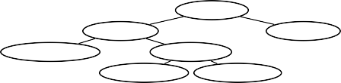
Complex Event Forecasting with Prediction Suffix Trees
b
a
a
start
0
a
1
2
b
b
E,(0.6,0.4)
a,(0.7,0.3)
b,(0.5,0.5)
aa,(0.75,0.25)
ba,(0.8,0.2)
aba,(0.9,0.1)
bba,(0.1,0.9)

Slide 69
Complex Event Forecasting with Prediction Suffix Trees
b
a
a
start
0
a
1
2
b
{1,aa}
b
E,(0.6,0.4)
a,(0.7,0.3)
b,(0.5,0.5)
aa,(0.75,0.25)
ba,(0.8,0.2)
aba,(0.9,0.1)
bba,(0.1,0.9)
▶ Let’s compute the waiting-time distributions.
▶ Assume automaton in state 1 and suffix is aa.
▶ Estimate distribution step by step, for k =1, k = 2, etc.

Slide 70

Complex Event Forecasting with Prediction Suffix Trees
{1,aa} ✖
b
a
a
a,0.75
start
0
a
1
2
b
{1,aa}
b
E,(0.6,0.4)
a,(0.7,0.3)
b,(0.5,0.5)
aa,(0.75,0.25)
ba,(0.8,0.2)
aba,(0.9,0.1)
bba,(0.1,0.9)
▶ k = 1.
▶ Assume another a arrives. Suffix still aa, automaton again in state 1.
▶ Reaches a non-final state. Not interested.

Slide 71

Complex Event Forecasting with Prediction Suffix Trees
{1,aa} ✖
b
a
a
a,0.75
start
0
a
1
2
b
{1,aa}
b
b,0.25
E,(0.6,0.4)
{2,b} ✔
a,(0.7,0.3)
b,(0.5,0.5)
aa,(0.75,0.25)
ba,(0.8,0.2)
aba,(0.9,0.1)
bba,(0.1,0.9)
▶ k = 1.
▶ Assume b arrives first. Suffix is b, automaton in state 2.
▶ Reaches a final state. No other options. Thus
P(W_{{1,aa}} = 1) = 0.25.

Slide 72
Complex Event Forecasting with Prediction Suffix Trees
{1,aa}
b
a
a
a,0.75
start
0
a
1
2
b
{1,aa}
{1,aba}
a,0.9
b
b,0.25
b,0.1
a,0.5
E,(0.6,0.4)
{2,b} ✖
a,(0.7,0.3)
b,(0.5,0.5)
b,0.5
aa,(0.75,0.25)
ba,(0.8,0.2)
{0,b}
a,0.5
aba,(0.9,0.1)
bba,(0.1,0.9)
b,0.5
▶ k = 2.
▶ Assume b arrives first. Suffix is b, automaton in state 2.
▶ Reaches a final state already at k = 1. All downstream paths pruned.

Slide 73

Complex Event Forecasting with Prediction Suffix Trees
{1,aa} ✖
a,0.75
b
a
{1,aa}
a
start
0
1
2
a,0.75
a
b
{1,aa}
b
{1,aba}
a,0.9
b,0.25
b,0.1
a,0.5
E,(0.6,0.4)
{2,b} ✖
a,(0.7,0.3)
b,(0.5,0.5)
aa,(0.75,0.25)
ba,(0.8,0.2)
b,0.5
aba,(0.9,0.1)
bba,(0.1,0.9)
{0,b}
a,0.5
b,0.5
▶ k = 2.
▶ Assume a arrives first. Then another a.
▶ Reaches a non-final state. Not interested.

Slide 74
Complex Event Forecasting with Prediction Suffix Trees
{1,aa} ✖
a,0.75
{1,aa}
b
a
a
b,0.25
a,0.75
{2,b} ✔
start
0
a
1
2
b
{1,aa}
{1,aba}
a,0.9
b
b,0.25
b,0.1
a,0.5
E,(0.6,0.4)
{2,b} ✖
a,(0.7,0.3)
b,(0.5,0.5)
b,0.5
aa,(0.75,0.25)
ba,(0.8,0.2)
{0,b}
a,0.5
aba,(0.9,0.1)
bba,(0.1,0.9)
b,0.5
▶ k = 2.
▶ Assume a arrives first. Then b.
▶ Reaches a final state at k = 2. Only path leading to a final at k = 2. Thus P(W_{{1,aa}} = 2) = 0.75 ∗ 0.25 = 0.1875.

Slide 75
Outline
Proactive Streaming Analytics at Scale:
                Motivation – Use Cases – Challenges
(Geo-)Distributed Proactive Stream Analytics – State-of-the-art (SOTA)
                The Case for Stream Synopses
                Complex Event Forecasting
                Intra-/Inter-cluster Optimization
Cherry-picks for S/W Components
                Synopses-as-a-Service Paradigm
                Distributed CEF Architecture
                Multi-cluster, Cross-platform & Adaptive Optimization
Hands-On RapidMiner Studio
                Architecture Overview
                Maritime Use Case
                Stock Market Use Case

Slide 76
Recall the setup we want to operate on….

Slide 77











Begin → End of Optimization Process
What we would want…
Logical Workflow
Physical Workflow
END
END
Op5
Op5
Op4
Op3
Op4
Op3
Op1
Op2
Op1
Op2
START
START

Slide 78
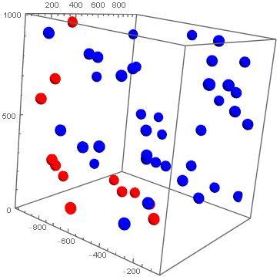
Pareto Optimal Resource Allocation
Pareto Optimal Physical Workflows
Overall Cost Combination of
                Throughput [T]
                Latency (network, processing) [L]
                Communication [C]
                …
                Cost=w1*T+w2*L+w3*C+…
++Performance Constraints
Communication
Latency
Throughput

Slide 79
Begin → End of Optimization Process
What exists…
Exemplary Logical Workflow
Exemplary
Physical Workflow
END
END
Op5
Op5
Op4
Op3
Op4
Op3
Op1
Op2
Op1
Op2
START
START

Slide 80
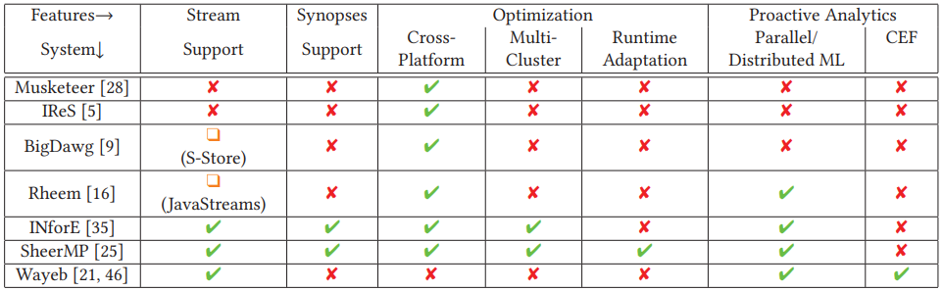
Optimization Approaches SOTA

Slide 81

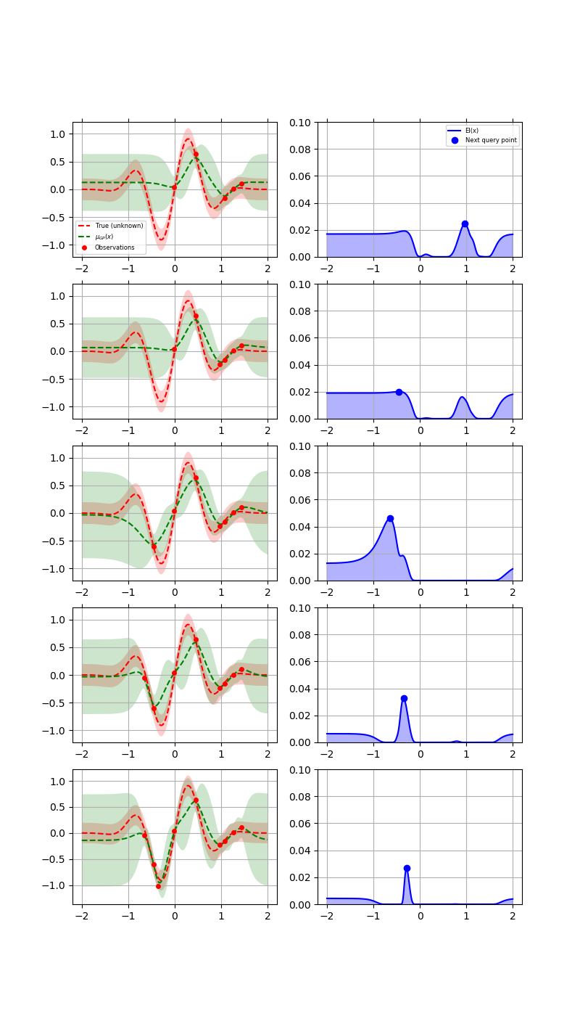

Optimization Process Generic View
Logical Workflow
Optimization Algorithm
Cost Model
Alternative (partial)
Physical Workflow i
What-if
Aggregate
Performance
Prescribe Physical Workflow
* used as examples, reviewed approaches do not necessarily support these platforms
81

Slide 82
Exhaustive Search Algorithm
|S| supported platforms, |Op| operators in the workflow
Pros: Optimal Solutions, Low Memory Requirements
Cons: High Time Complexity, Scales poorly with |S| and |Op|
Used in BigDawg, IReS, Masketeer
Consider all possible platforms for Join
Having considered all possible platforms for the 2 Filter upstream ops
Same applies to all operators & entire workflow
END
Op5
Op4
Op3
|S| ways to fill in
Op1
Op2
…
|Op| positions
START
|S|^{|Op|} Time Complexity $×$|Op| for cost computation
82

Slide 83
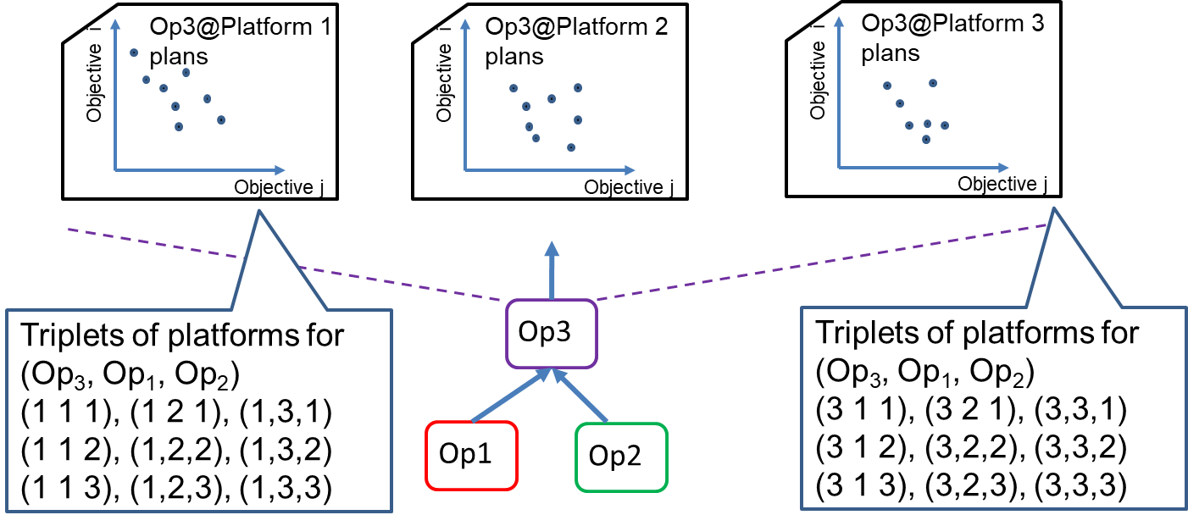
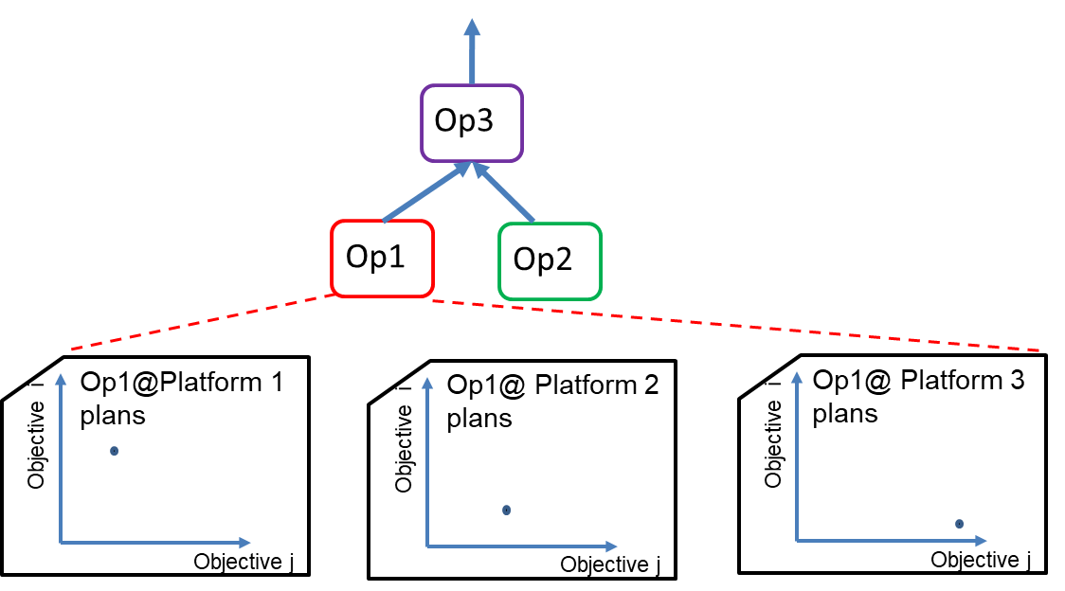
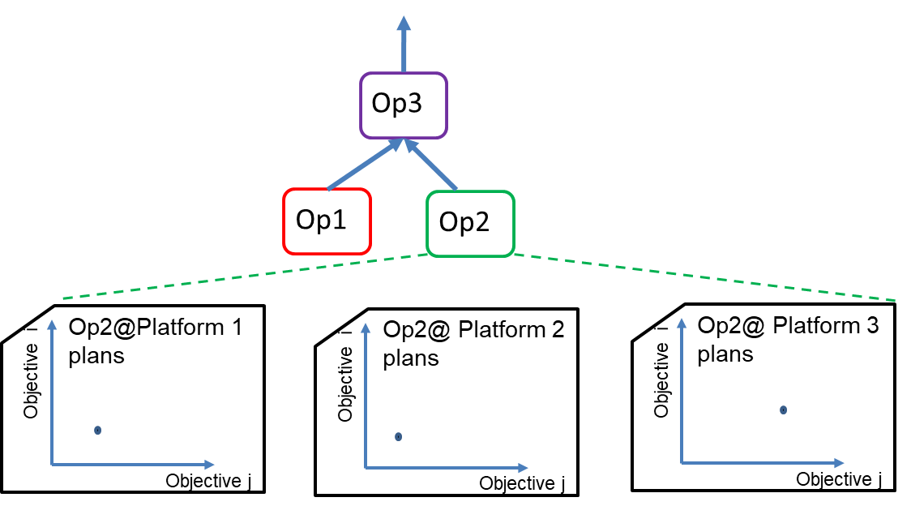
Exhaustive Search Algorithm

Slide 84
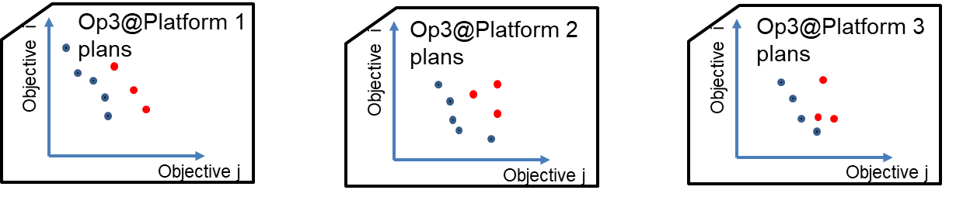

Dynamic Programming Algorithm

Slide 85
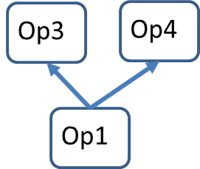
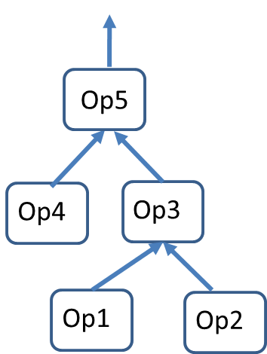

Dynamic Programming Algorithm
|U| maximum number of upstream operators among Op_{i}s
Pros: Optimal Solutions (wo operator sharing), Practically Lower Time Complexity
Cons: Higher Memory Requirements
Similar to IReS, Masketeer
Op5 will consider only Pareto Optimal placements of Op3 & Op4
NOT all possible placements for Op1, Op2, Op3, Op4
Shared Operator
Time Complexity: |Op| $×$ |S|^{U}
Space Complexity: |Op| $×$|S| $×$T

Slide 86
Evolutionary Search Algorithm
Similar to IReS
Fixed number of examined placements and algorithm iterations
Set P of size N(=6) of possible placements per operator Op1, Op2

Slide 87
Evolutionary Search Algorithm
Used in IReS
Set P of size N(=6) of possible placements per operator Op1, Op2
Some random permutations for downstream operator Op3

Slide 88
Evolutionary Search Algorithm
Used in IReS
Set P of size N(=6) of possible placements per operator Op1, Op2
Some random permutations for upstream operator Op3
Compute Pareto front(s) - ranks

Slide 89
Evolutionary Search Algorithm
Set P of size N(=6) of possible placements per operator Op1, Op2
Generate some random permutations for upstream operator Op3
Compute Pareto front(s) - ranks
Keep N(=6) most (crowding) distant with each other
Crossover upstream and repeat for a fixed number of iterations

Slide 90
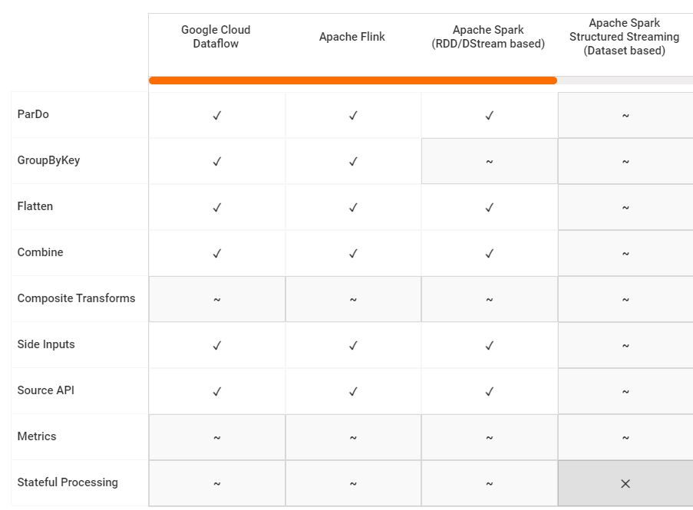
Short Plug – Apache Beam
Platform → Operation ↓ | Apache Flink | Spark Streaming | Spark Structured Streaming
ParDo | ٧ | ٧ | ~
GroupByKey | ٧ | ~ | ~
Flatten | ٧ | ٧ | ~
Combine | ٧ | ~ | ~
Composite Transforms | ~ | ~ | ~
Side Inputs | ٧ | ٧ | ~
Source API | ٧ | ٧ | ~

Slide 91
Lossless Heuristic Search
Originated from Rheem (now Apache Waywang)
Inflated Operators + Communication Channels
Logical
Operator
Physical Interpretations per Platform
Op1
Op1a@platform 1
Op1b@platform 2
Op1c@platform 2
Op1d@platform 3
Op1e@platform 3
Op1f@platform 3

Slide 92


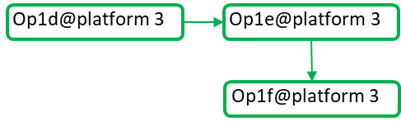


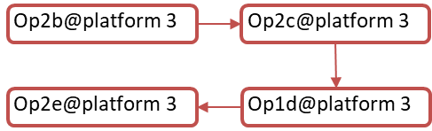
Lossless Heuristic Search
Originated from Rheem (now Apache Waywang)
Concept of Boundary Operators
Logical Plan
Physical Interpretations per Platform
Op1
Op2

Slide 93


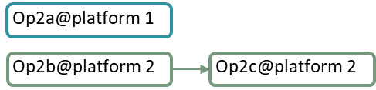

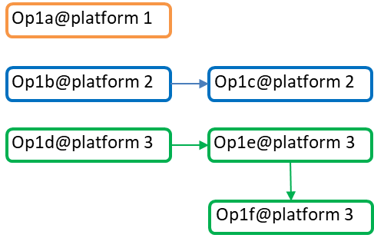
Lossless Heuristic Search
Pruned placement enumeration based on local optimality
ML-based Cost Estimation and Aggregation
Duplicate Insensitive Operator Sharing
Op4
Op2
Op3
Op1

Slide 94
Lossless Heuristic Search
Pruned placement enumeration based on local optimality
ML-based Cost Estimation and Aggregation
Duplicate Insensitive Operator Sharing
Op4
Op2
Op3
Op1

Slide 95
Lossless Heuristic Search
Pruned placement enumeration based on local optimality
ML-based Cost Estimation and Aggregation
Duplicate Insensitive Operator Sharing
Op24
Op34
Op12
Op13

Slide 96
Lossless Heuristic Search
Pruned placement enumeration based on local optimality
ML-based Cost Estimation and Aggregation
Duplicate Insensitive Operator Sharing
Op124
Op134

Slide 97

Lossless Heuristic Search
Pruned placement enumeration based on local optimality
ML-based Cost Estimation and Aggregation
Duplicate Insensitive Operator Sharing
Op1234

Slide 98
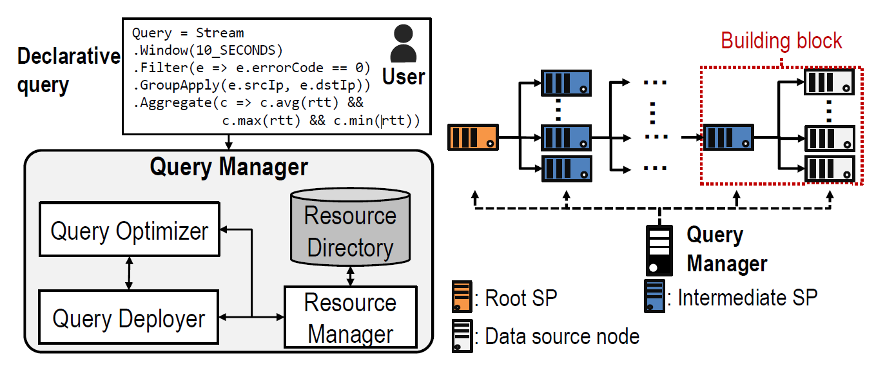
Jarvis for Efficient Statistic/Log Collection
A. Sandur, C. Park, S. Volos, G. Agha, M. Jeon: Jarvis: Large-scale Server Monitoring with Adaptive Near-data Processing. ICDE 2022

Slide 99
Summing-Up
Prior Art
                No native stream synopsis API w 3 types of scalability
                No scalable/parallel CEF - No sufficient expressive power
                No multi-cluster+cross-platform support for streaming workflows
                Requires programming effort often defining their own languages
                Our Goal→ Fill these gaps + deploy in a commercial platform with vast user base

Slide 100
Outline
Proactive Streaming Analytics at Scale:
                Motivation – Use Cases – Challenges
(Geo-)Distributed Proactive Stream Analytics – State-of-the-art (SOTA)
                The Case for Stream Synopses
                Complex Event Forecasting
                Intra-/Inter-cluster Optimization
Cherry-picks for S/W Components
                Synopses-as-a-Service Paradigm
                Distributed CEF Architecture
                Multi-cluster, Cross-platform & Adaptive Optimization
Hands-On RapidMiner Studio
                Architecture Overview
                Maritime Use Case
                Stock Market Use Case

Slide 101


Synopses Data Engine-as-a-Service (SDEaaS)
Implemented on Apache Flink
Kafka + JSON for cross-platform support
Synopses sharing among many workflows
101

Slide 102
Synopses Data Engine-as-a-Service Paradigm
SDEaaS Features
                Constantly running job in one or more clusters
                Build/Stop, Query (Ad-hoc/Continuous), Plug-in synopses on-the-fly
                Re-uses common synopses across concurrent workflows (avoids duplicating common streams and synopses)
                Concurrent maintenance of various synopses of various types
                Each new synopsis reserves tasks, while without SDEaaS reserves entire task slots (CPU cores ~ task slots < tasks)
                Cannot use native Flink windowing support

Slide 103
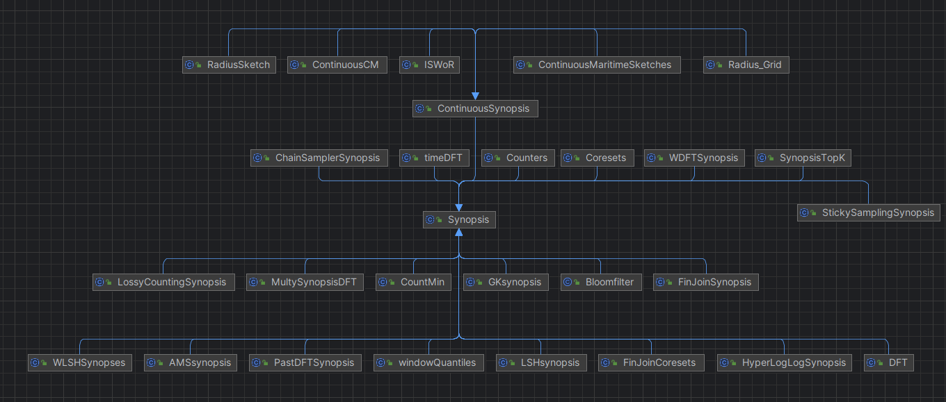
SDE Class Hierarchy

Slide 104
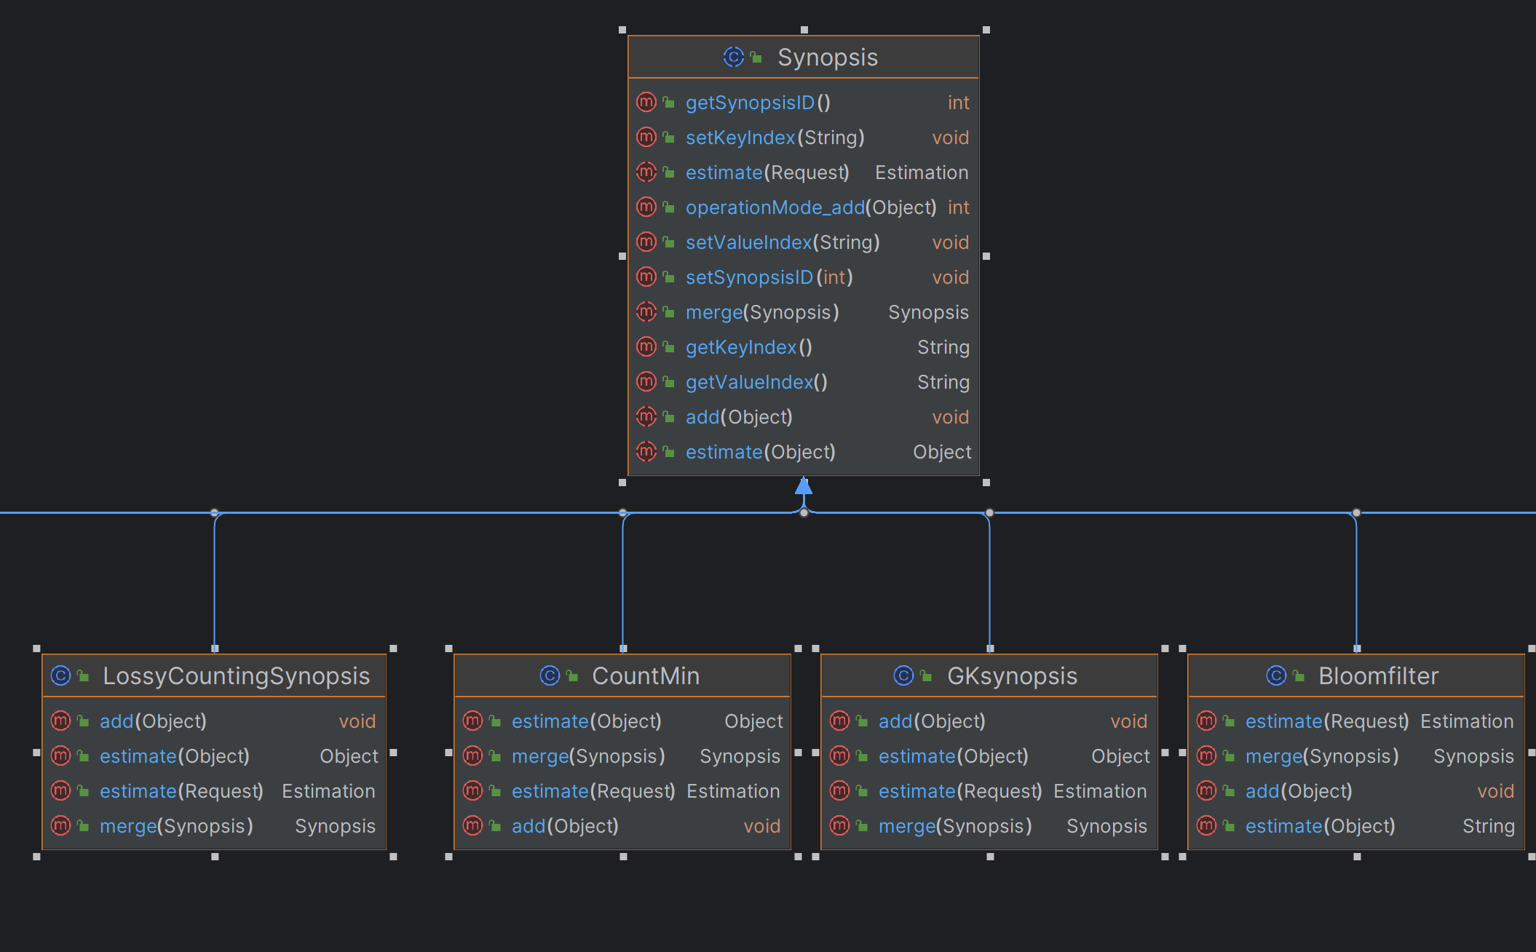
SDE Class Hierarchy

Slide 105
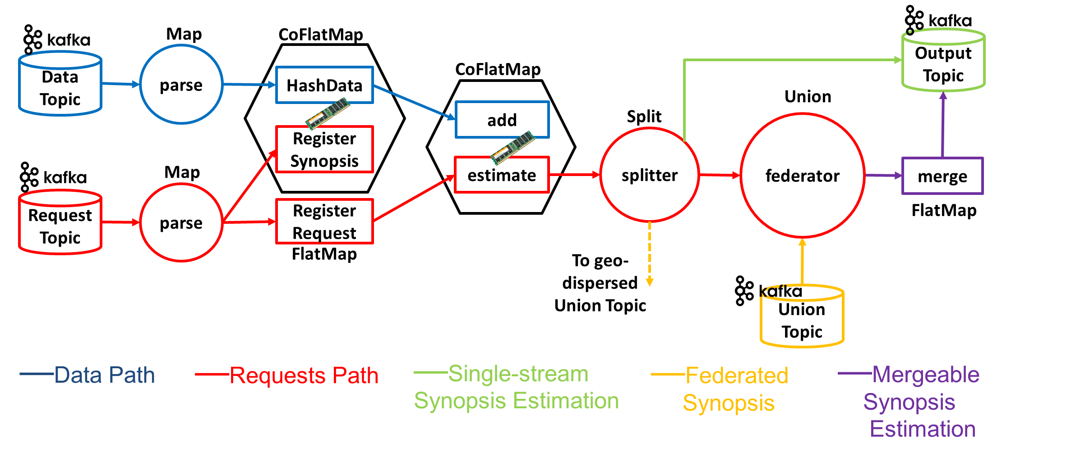
SDE Architecture – Condensed View
A. Kontaxakis et al: A Synopses Data Engine for Interactive Extreme-Scale Analytics. CIKM 2020
New Synopsis maintenance request
**each CoFlatMap hosts 2 FlatMap operators
Produce keys pointing to workers
A. Kontaxakis et al: And synopses for all: A synopses data engine for extreme scale analytics-as-a-service. Inf. Syst. 116: 102221 (2023)

Slide 106
SDE Architecture – Condensed View
Updating a synopsis upon new data tuple arrival
Lookup keys of workers handling that synopsis

Slide 107
SDE Architecture – Condensed View
Querying a synopsis
Look up keys to workers

Slide 108
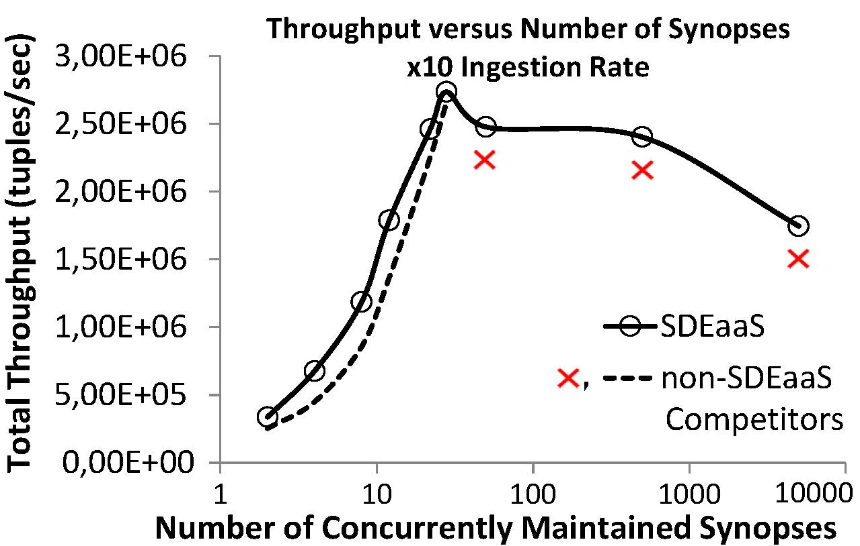
SDE Highlights

Slide 109
Outline
Proactive Streaming Analytics at Scale:
                Motivation – Use Cases – Challenges
(Geo-)Distributed Proactive Stream Analytics – State-of-the-art (SOTA)
                The Case for Stream Synopses
                Complex Event Forecasting
                Intra-/Inter-cluster Optimization
Cherry-picks for S/W Components
                Synopses-as-a-Service Paradigm
                Distributed CEF Architecture
                Multi-cluster, Cross-platform & Adaptive Optimization
Hands-On RapidMiner Studio
                Architecture Overview
                Maritime Use Case
                Stock Market Use Case

Slide 110
Hyper-paremeter tuning for Complex Event Forecasting
▶ Complex Event Forecasting systems have hyper-parameters, e.g., model order, confidence threshold, etc.
▶ Finding the proper values through exhaustive search may be sub-optimal.

Slide 111
Hyper-paremeter tuning for Complex Event Forecasting
▶ Complex Event Forecasting systems have hyper-parameters, eg model order, confidence threshold, etc.
▶ Finding the proper values through exhaustive search may be sub-optimal.
▶ Efficient search of the hyper-parameter space with Bayesian Optimization.

Slide 112
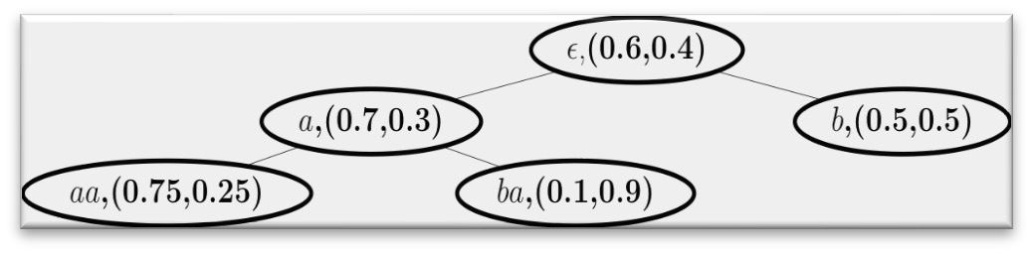
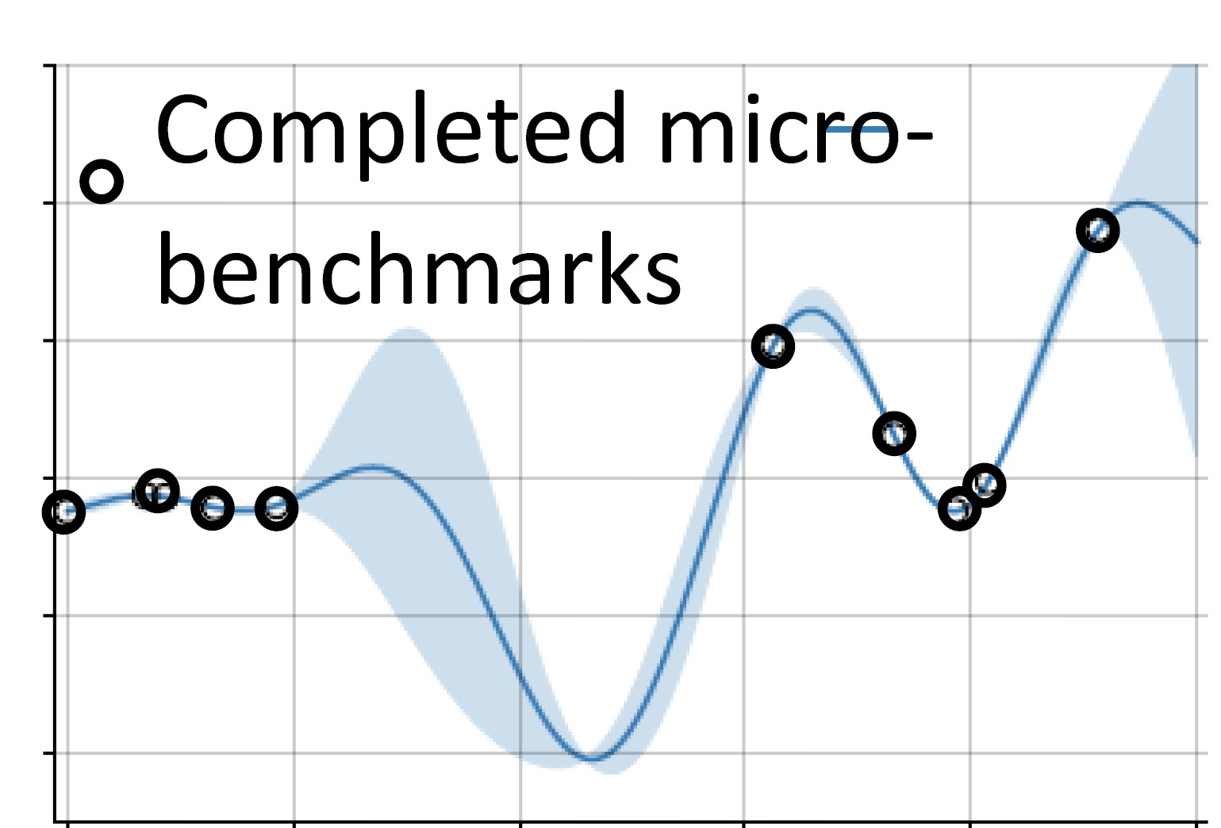
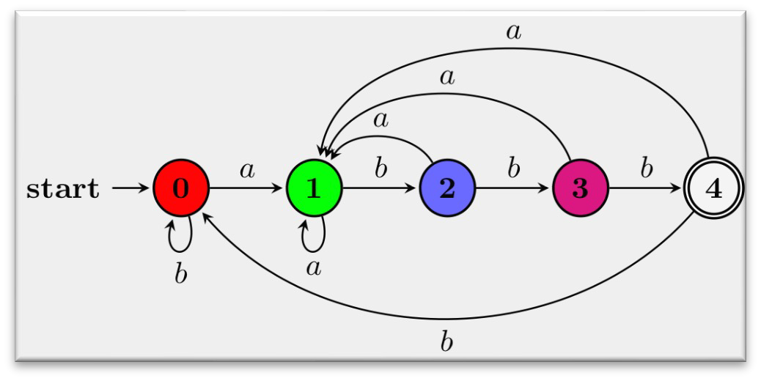
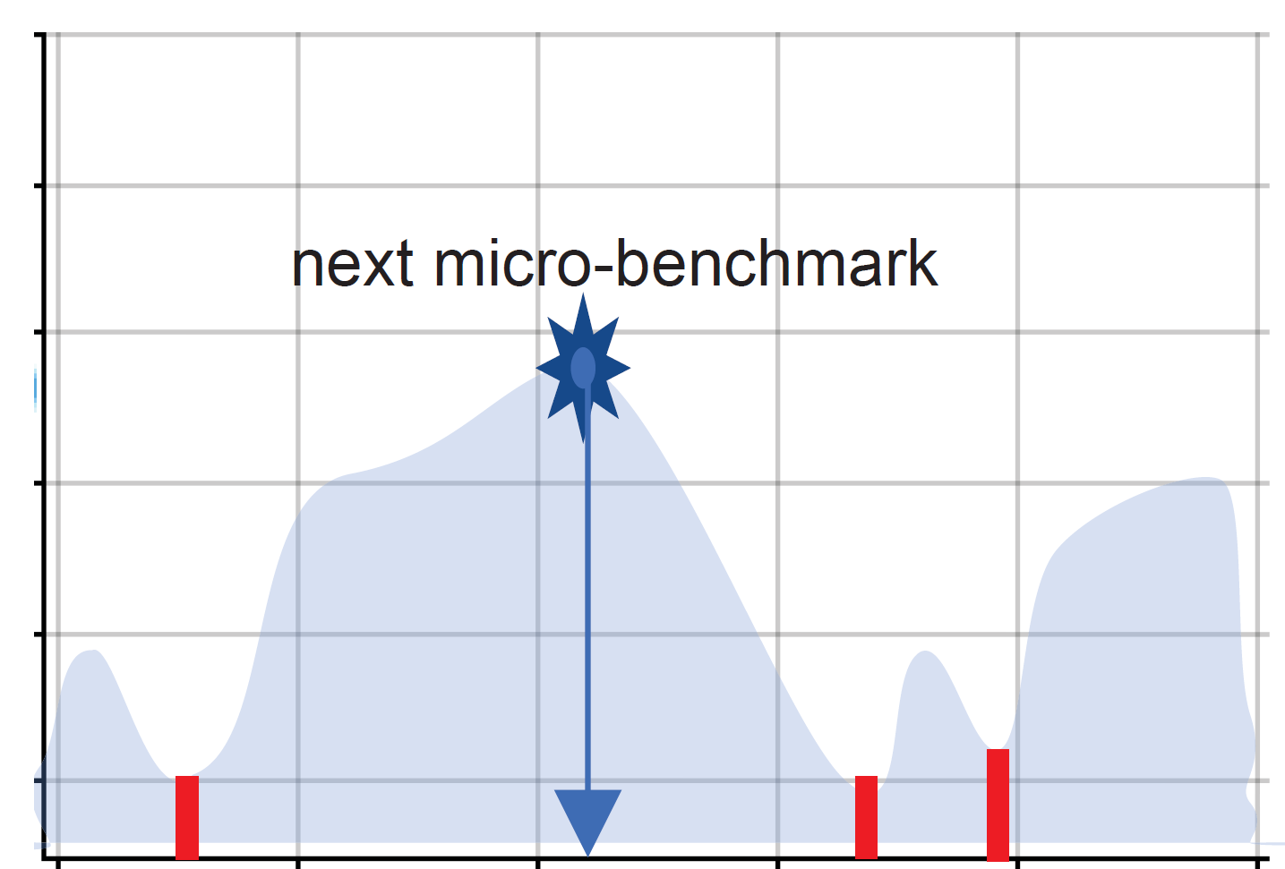
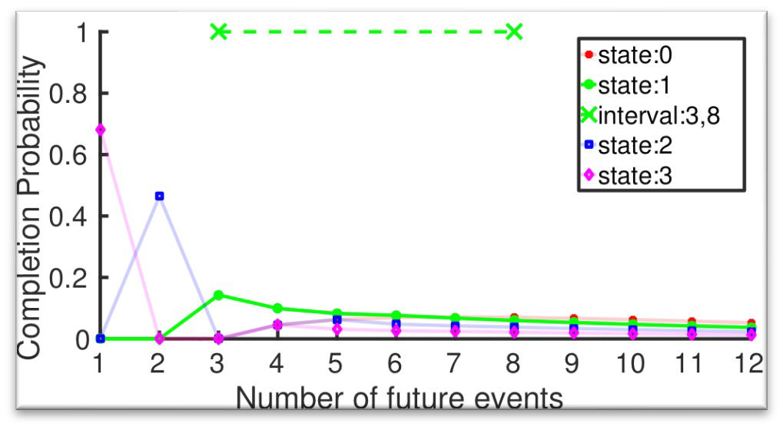
Bayesian Optimization for Complex Event Forecasting∗
Wayeb CEF Engine
BO Cost Modeler
m, pMin, γ
Learning a prediction suffix tree
Estimation of waiting-time distributions for each state
Construction of forecasts
BO (GPR) Model
Completed micro- benchmarks
Acquisition Function
Next micro-benchmark
c
Statistics Collector
Score
Training Data
Training Time (tt), Accuracy (MCC)
c
^{θ}fc
Acq. func. value
Validation
Data
if ¬convergence()
run micro-benchmark
^{else deploy c}opt^{[m, θ}fc^{, pMin, γ]}
Benchmarker
^{Prescribed next c=[m,θ}fc^{,pMin,γ]} micro-benchmark
^{Current optimal c}opt^{[m, θ}fc^{, pMin, γ]}
∗Stavropoulos et al, Optimizing complex event forecasting. Distributed and Event-based Systems (DEBS), 2022.

Slide 113
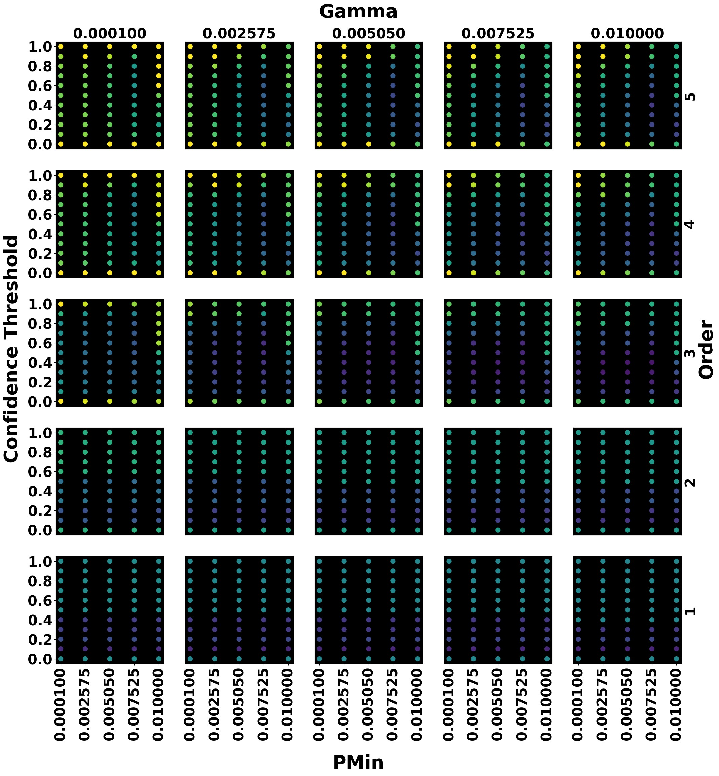
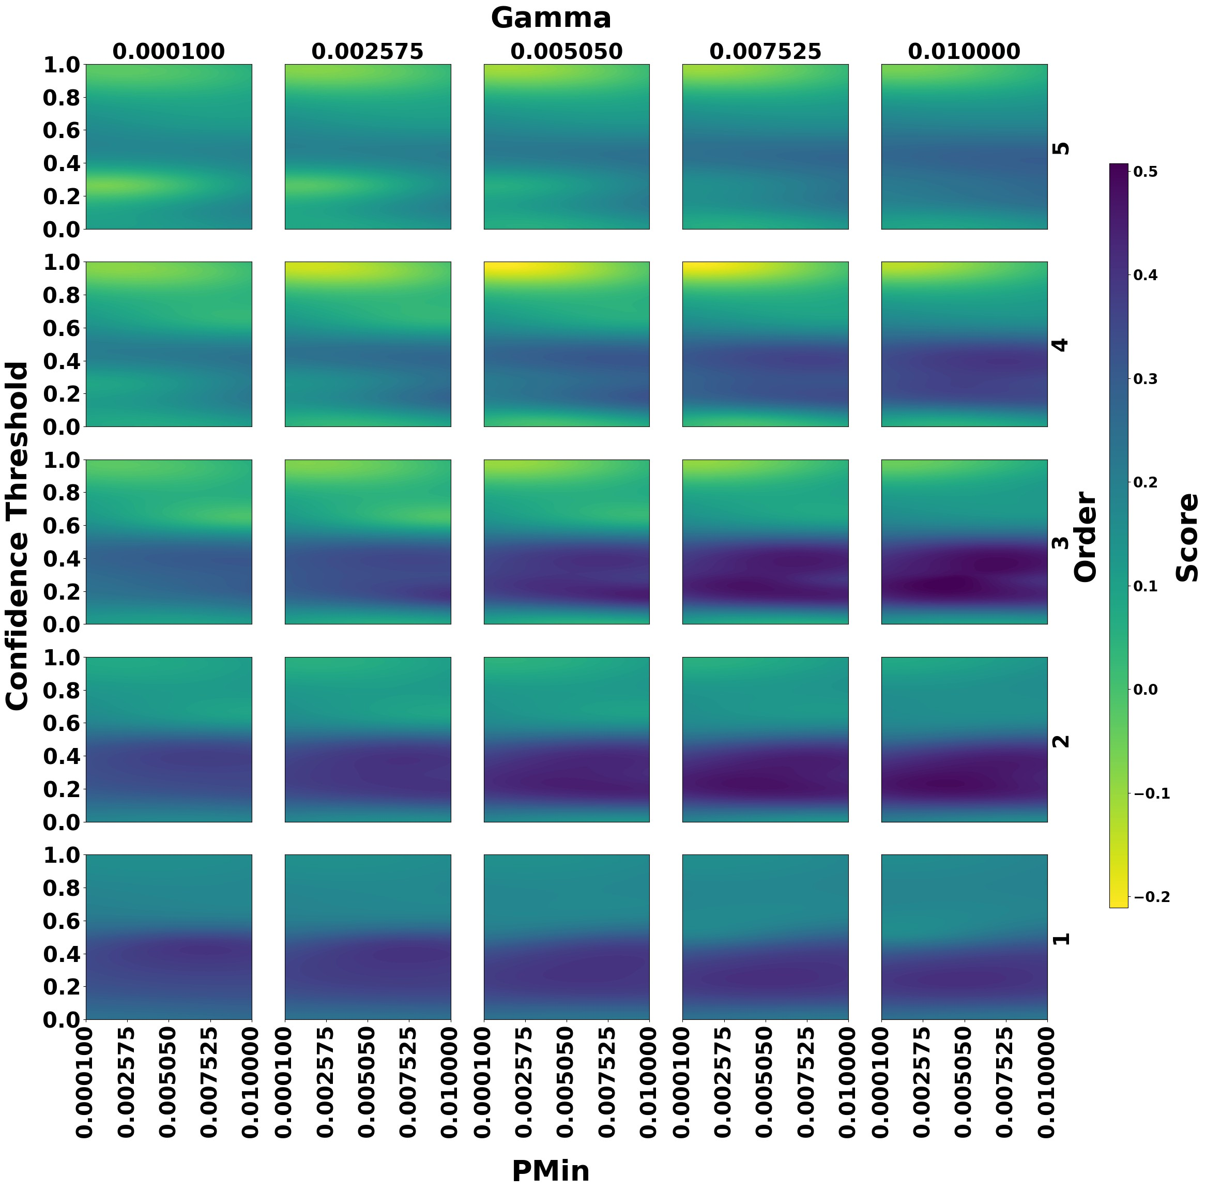
Exhaustive search vs Bayesian Optimization

Slide 114
Parallel Complex Event Forecasting∗
CEP Engine
event1 event2
...
CEP Engine
pattern1
flinkSource
...
pattern2
...
eventN
CEP Engine
patternN
Pattern-based parallelization.
CEP Engine
event1 event2
...
CEP Engine
pattern1
flinkSource
...
pattern2
...
eventN
CEP Engine
patternN
Partition-based parallelization.
∗Ntoulias et al, Online fleet monitoring with scalable event recognition and forecasting. GeoInformatica, 2022.

Slide 115

Execution time & Back-pressure

Slide 116

Execution time & Back-pressure
par = 1
par = 2
par = 3
par = 4
par = 5
par = 6
0.8
Backpressure
0.6
0.4
0.2
0
0 5 10 15
Number of threads of the CER operator

Slide 117
Outline
Proactive Streaming Analytics at Scale:
                Motivation – Use Cases – Challenges
(Geo-)Distributed Proactive Stream Analytics – State-of-the-art (SOTA)
                The Case for Stream Synopses
                Complex Event Forecasting
                Intra-/Inter-cluster Optimization
Cherry-picks for S/W Components
                Synopses-as-a-Service Paradigm
                Distributed CEF Architecture
                Multi-cluster, Cross-platform & Adaptive Optimization
Hands-On RapidMiner Studio
                Architecture Overview
                Maritime Use Case
                Stock Market Use Case

Slide 118

What is different?
Many (geo-dispersed) clusters each hosting $≥1$ Big Data platforms
                Combinatorial space explodes
                Communication Cost involved
                Network (besides Processing) Latency involved
Cost Estimation
                Requirements for lightweight models
                Incremental → recent history only matters
Adaptivity as a first-class citizen
                Long-running streaming workflows
                Volatile data distributions & workloads

Slide 119

Cherry-picking Optimization Algorithms
Exhaustive Search & Dynamic Programming
                Adapted for multi-cluster + cross-platform scenarios and various parallelization degrees per operator
                Adapted for Adaptation (discussed shortly)
Evolutionary Search
                Difficult to adapt for adaptation due to randomization aspects
                Crowding distance counter-intuitive for adaptation
                Repeated tuning required for streaming setups

Slide 120





Cherry-picking Optimization Algorithms
Lossless Heuristic Enumeration
                Meta-optimization Design Choice: no operator inflation
                No Channel Conversion Design Choice: Kafka→de facto standard

Slide 121
Reminder: Begin → End of Optimization Process
Logical Workflow
Physical Workflow
END
END
Op5
Op5
Op4
Op3
Op4
Op3
Op1
Op2
Op1
Op2
START
START

Slide 122
Lossless A*-alike Search Algorithm
Logical Workflow
Standard A*
Not applicable
END
END
Op5
Op5
Op4
Op3
Op4
Op1
Op2
START
START
122

Slide 123

Lossless A*-alike Search Algorithm
N. Giatrakos et al: INforE: Interactive Cross-platform Analytics for Everyone. CIKM 2020
Logical Workflow
Novel A*
END
END
Op5
Op5
Op4
Op3
Op4
Op3
Op1
Op2
Op1
Op2
START
START
G. Stamatakis et al: SheerMP: Optimized Streaming Analytics-as-a-Service over Multi-site and Multi-platform Settings. EDBT 2022
123

Slide 124
A*-alike Search Algorithm
Key Ideas
  RealCost – from START to (Opi@Site, Parallel Degree)
  HeuristicCost – How much to reach END?
  EstimatedCost – RealCost+HeuristicCost
Priority Queue
  First examine candidate with lower Estimated Cost
END
Op5
Op4
Op3
Op1
Op2
START
124

Slide 125
A*-alike Search Algorithm - Heuristic
  Reverse Topological Sort
END
Heuristic Cost of END=0
125

Slide 126
A*-alike Search Algorithm - Heuristic
  Heuristic Cost Aggregate Stream = Minimum of the below +
  Heuristic Cost of END
  Reverse Topological Sort
END
Compute Minimum
BO model
Op5
Ask Aggregate Cost
BO model
Ask Aggregate Cost
BO model
Ask Aggregate Cost
126

Slide 127
A*-alike Search Algorithm - Heuristic
  Heuristic Cost Join = Minimum of the below +
  Heuristic Cost of Aggregate
  Reverse Topological Sort
END
Compute Minimum
Op5
BO model
Op4
Op3
Ask Join Cost
BO model
Ask Join Cost
BO model
Ask Join Cost
127

Slide 128
A*-alike Search Algorithm - Heuristic
  Reverse Topological Sort
END
  Heuristic Cost START =
  Max{
  Heuristic Cost of
  Heuristic Cost of
  Heuristic Cost of
  } + Min of START(=0)
Op5
Op4
Op3
Op1
Op2
START
128

Slide 129
A*-alike Search Algorithm - Heuristic
PriorityQueue (keeps plans NOT operators)
START
END
Op5
Dequeue
Op4
Op3
PriorityQueue (Enqueue)
Op1
Op2
START
START
START
129

Slide 130
A*-alike Search Algorithm
PriorityQueue
END
START
START
Op5
Estimated Cost 1 < Estimated Cost 2
where Estimated Cost = Real+Heuristic
Op4
Op3
Dequeue
Op1
Op2
Which operator to add? Filter or Select
Join not selectable
START
130

Slide 131
A*-alike Search Algorithm
PriorityQueue
START
START
START
Estimated Cost 1 < Estimated Cost 2 < Estimated Cost 3
131

Slide 132
A*-alike Search Algorithm
PriorityQueue
START
START
START
Upon Dequeue of Join can be added
START
132

Slide 133



A*-alike Search Algorithm
@END: Most solutions in queue with EstimatedCost > currentBest are pruned
PriorityQueue
133

Slide 134

Heuristic Search Algorithm – Join Vicinity Example
  Latency (S₁,S₂)=7+7=14
  Latency(S₃,S₁)=7<14 → S₃ enters the vicinity
  No other site enters the vicinity of S₁
  No other site enters the vicinity of S₂
  No other site enters the vicinity of S₃
Op5
Op4
Op3
Op1
Op2
16ms
10ms
3ms
8ms
S₄
S₁
Similarly for:
- Communication
- Throughput
18ms
9ms
8ms
6ms
5ms
7ms
Op2
S₃
11ms
S₂
7ms
I. Flouris et al: Network-wide complex event processing over geographically distributed data sources. Inf. Syst. 88 (2020)
Op1
134

Slide 135


Greedy Variants
Greedy+ keeps one Pareto front per operator
Greedy keeps locally optimal solution per operator
I. Flouris et al: Network-wide complex event processing over geographically distributed data sources. Inf. Syst. 88 (2020)

Slide 136

Performance inc. Adaptation
  Should account for…
    Cost of currently running (Root) plan
    Cost of candidate plan
    Migration Cost
    Each with its own w1*T+w2*L+w3*C
    Overall cost=
Cost Root Plan – Cost Candidate Plan + Migration Cost

Slide 137



Algorithms Adapted for Adaptation
  Find common part
  Compute deltas
  Compute migration cost

Slide 138
Optimization Algorithm Performance Highlights
Algorithm Execution Time
                Exhaustive Search > x10 A* for small/medium workflows/networks >x10 Heuristic ~x10 Greedy
Proximity to Optimal Physical Workflow
                Exhaustive, A* ~100%
                > 80% Heuristic, Greedy
Physical Plan Discovery Rate
                Exhaustive, A* ~100%
                Heuristic 90 – 100%
                Greedy >75%
G. Stamatakis et al: SheerMP: Optimized Streaming Analytics-as-a-Service over Multi-site and Multi-platform Settings. EDBT 2022

Slide 139

In-network Operator Placement & Μulti-Cluster Configurations
Physical Workflow
END
START

Slide 140

Statistics Collection & Runtime Adaptation
Update
Cost model
Incrementally
Statistics

Slide 141


Cost Estimator: Benchmarking Mode
Benchmarked operator/workflow
Cost model
Bayesian Opt.
Input data/source
dimensions
performance dimensions
source type,
input rate,
output type,
parallelism
…
throughput,
latency,
comm. cost,
…
how to improve?
execute next microbenchmark
More on ML alternatives for cost estimation:
Dimitris Tsesmelis, Alkis Simitsis: Database Optimizers in the Era of Learning. ICDE 2022
INFORE Optimizer & SDE & OMLDM

Slide 142


SheerMP Optimizer Architectural View

Slide 143
Outline
Proactive Streaming Analytics at Scale:
                Motivation – Use Cases – Challenges
(Geo-)Distributed Proactive Stream Analytics – State-of-the-art (SOTA)
                The Case for Stream Synopses
                Complex Event Forecasting
                Intra-/Inter-cluster Optimization
Cherry-picks for S/W Components
                Synopses-as-a-Service Paradigm
                Distributed CEF Architecture
                Multi-cluster, Cross-platform & Adaptive Optimization
Hands-On RapidMiner Studio
                Architecture Overview
                Maritime Use Case
                Stock Market Use Case

Slide 144
Architecture Overview
Let’s go live on RapidMiner Studio!

Slide 145

Stock Market Use Case – Optimization & Adaptation Oriented
https://youtu.be/LuynM3wPRNA

Slide 146

Maritime Use Case – Complex Event Forecasting Oriented
https://www.youtube.com/watch?v=q2wxlgLjjiQ

Slide 147
Open Issues
Stream Summarization
                SDEaaS + Condor
                Portability to other Big Data platforms (CoFlatMap transform matters!)
Complex Event Forecasting
                CEF under automatic rule discovery
                In-network CEF
Cross-platform & Multicluster Optimization of Streaming Analytics
                SheerMP + Jarvis + Wayeb Optimizer
                Hybrid (batch & streaming) workloads
                Extensions to IoT platforms

Slide 148


ngiatrakos softnet.tuc.gr alevizos.elias iit.demokritos.gr adeli softnet.tuc.gr rklinkenberg altair.com a.artikis iit.demokritos.gr
Thank you!
Q&A
https://www.softnet.tuc.gr/en/research/journeycikm23tutorial
Horizon Europe

